Slide 1
The
Better
Parts

Slide 2
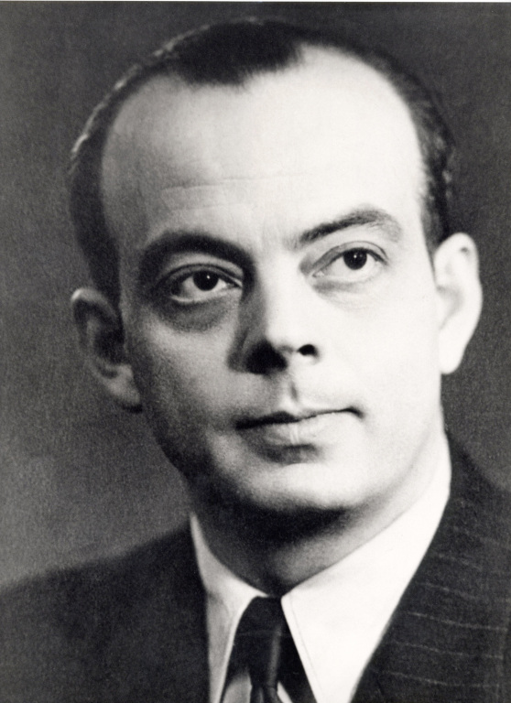
Antoine de Saint-Exupéry
Antoine de Saint-Exupéry

Slide 3


Slide 4
Il semble que la perfection soit atteinte non quand il n’y a plus rien à ajouter, mais quand il n’y a plus rien à retrancher.
Antoine de Saint-Exupéry
Terre des Hommes, 1939
It seems that perfection is attained
not when there is nothing more to add,
but when there is nothing more to subtract.

Slide 5
Good Parts
It seems that perfection is attained
not when there is nothing more to add,
but when there is nothing more to subtract.

Slide 6
If a feature is sometimes useful and sometimes dangerous and if there is a better option then always use the better option.

Slide 7
We are not paid to use every feature of the language.
We are paid to write programs that work well and are free of error.

Slide 8
We are not paid to use every feature of the language.
We are paid to write programs that work well and are free of error.

Slide 9
A good programming language should teach you.

Slide 10
I made every mistake with JavaScript you could make.

Slide 11
JSLint

Slide 12
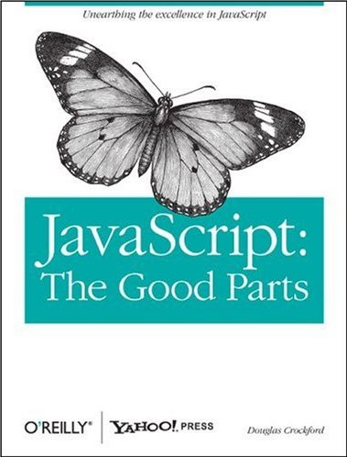

Slide 13
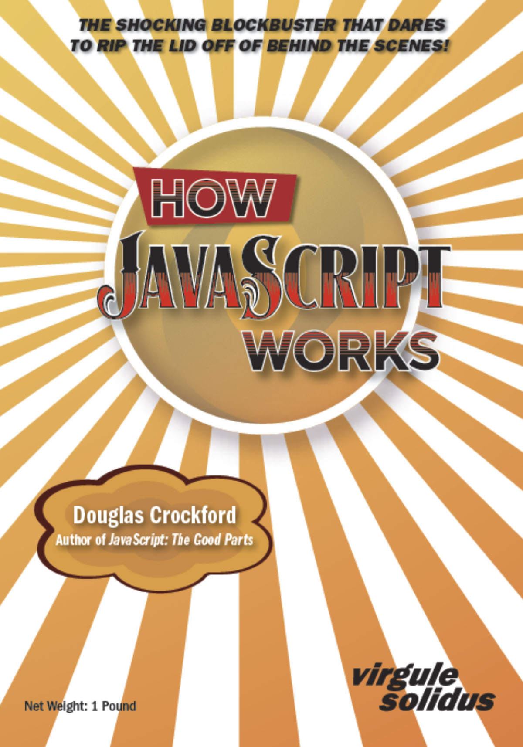

Slide 14
Arguments against good parts
Just a matter of opinion.
Every feature is an essential tool.
It is sometimes useful.
I have a right to use every feature.
I need the freedom to express myself.
I need to reduce my keystrokes.
It is an insult to suggest that I would ever make a mistake with a dangerous feature.
There is a good reason those features were added to the language.

Slide 15
Foot Guns
Brendan Eich

Slide 16
The purpose of a programming language is to aid programmers in producing error-free programs.

Slide 17
It is not possible to write good programs in JavaScript.

Slide 18
It is not only possible to write good programs in JavaScript, it is necessary.
It is not possible to write good programs in JavaScript.

Slide 19
Java ≠ JavaScript

Slide 20
Java ≠ JavaScript
Star Trek
Star Wars

Slide 21
Java ≠ JavaScript
Star Trek
Star Wars
Phasers
Photon Torpedoes
Uniforms
Regulations

Slide 22
Java ≠ JavaScript
Star Trek
Star Wars
Phasers
Photon Torpedoes
Uniforms
Regulations
Light Sabres & Blasters
Proton Torpedoes
Sand
Chaos

Slide 23
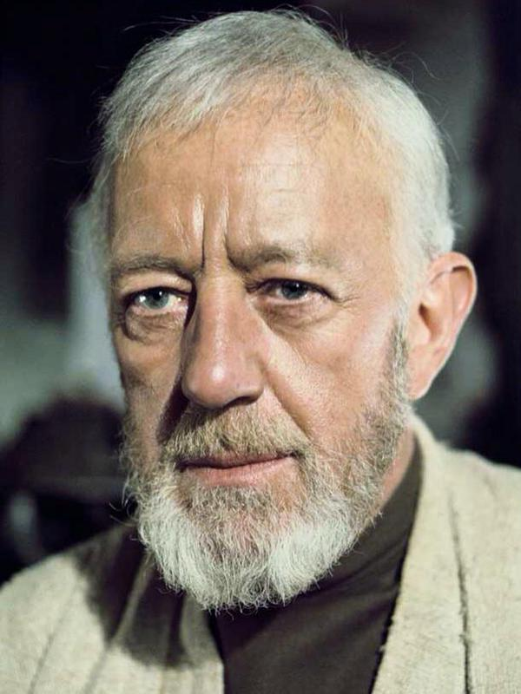

Slide 24
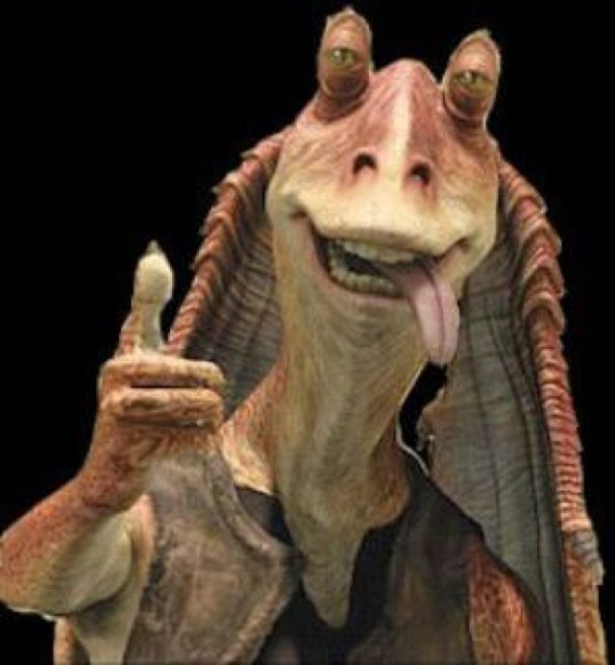

Slide 25
Meesa web ninja!

Slide 26
The fantasy of infallibility.
The futility of faultlessness.

Slide 27
Danger Driven Development

Slide 28
;

Slide 29
Scheduling
The time it takes to write the code.
The time it takes to make the code work right.
Always take the time to code well.

Slide 30
New Good Parts in ES6
Proper tail calls:
return func();

Slide 31
New Good Parts in ES6
Proper tail calls
Ellipsis... also known as ...rest, aka ...spread
function curry(func, ...first) {
return function (...second) {
return func(...first, ...second);
};
}
function curry(func) {
var slice = Array.prototype.slice, args = slice.call(arguments, 1);
return function () {
return func.apply(null, args.concat(slice.call(arguments, 0)));
};
}

Slide 32
New Good Parts in ES6
Proper tail calls
Ellipsis
Module
import big_integer from "./big_integer.js";
export default Object.freeze(...);

Slide 33
New Good Parts in ES6
Proper tail calls
Ellipsis
Module
let and const
  const fax;
  fax = faz; // bad
  fax.fay = faz; // ok

Slide 34
New Good Parts in ES6
Proper tail calls
Ellipsis
Module
let and const
Destructuring
let {that, other} = some_object;
let that = some_object.that, other = some_object.other;

Slide 35
New Good Parts in ES6
Proper tail calls
Ellipsis
Module
let and const
Destructuring
WeakMap

Slide 36
New Good Parts in ES6
Proper tail calls
Ellipsis
Module
let and const
Destructuring
WeakMap
Megastring literals

Slide 37
var rx_number = /^(0(?:b[01]+|o[0-7]+|x[0-9a-fA-F]+|\.[0-9]+(?:e[+\-]?[0-9]+)?)?|[1-9][0-9]*(?:\.[0-9]+)?(?:e[+\-]?[0-9]+)?)$/;
function mega_regexp(str, fl) {
return new RegExp(str.replace(/\s/g, ''), fl);
}
const rx_number = mega_regexp(`^(
0 (?:
b [01]+
| o [0-7]+
| x [0-9 a-f A-F]+
| \. [0-9]+ (?: e [+\-]? [0-9]+ )?
)?
| [1-9] [0-9]*
(?: \. [0-9]+ )? (?: e [+\-]? [0-9]+ )?
)$`);

Slide 38
var rx_number = /^(0(?:b[01]+|o[0-7]+|x[0-9a-fA-F]+|\.[0-9]+(?:e[+\-]?[0-9]+)?)?|[1-9][0-9]*(?:\.[0-9]+)?(?:e[+\-]?[0-9]+)?)$/;
function mega_regexp(str, fl) {
return new RegExp(str.replace(/\s/, ''), fl);
}
const rx_number = mega_regexp(`^(
0 (?:
b [01]+
| o [0-7]+
| x [0-9 a-f A-F]+
| \. [0-9]+ (?: e [+\-]? [0-9]+ )?
)?
| [1-9] [0-9]*
(?: \. [0-9]+ )? (?: e [+\-]? [0-9]+ )?
)$`);
http://jex.im/regulex

Slide 39
(name) => {id: name}

Slide 40
class

Slide 41
Good Parts Reconsidered
I stopped using new years ago.
Use Object.create instead.

Slide 42
Good Parts Reconsidered
I stopped using new years ago.
I have stopped using Object.create.

Slide 43

Good Parts Reconsidered
I stopped using new years ago.
I have stopped using Object.create.
I have stopped using this. [ADsafe.org]

Slide 44
Good Parts Reconsidered
I stopped using new years ago.
I have stopped using Object.create.
I have stopped using this.
I have stopped using null.

Slide 45
Good Parts Reconsidered
I stopped using new years ago.
I have stopped using Object.create.
I have stopped using this.
I have stopped using null.
I have stopped using falsiness.

Slide 46
Loops Reconsidered
I don’t use for.
I now use array.forEach and its many sisters.
I don’t use for in. I now use Object.keys(object).forEach.
ES6 has proper tail calls.
I will stop using while.

Slide 47
function repeat(func) {
while (func() !== undefined) {
}
}
function repeat(func) {
if (func() !== undefined) {
return repeat(func);
}
}

Slide 48
The Next Language

Slide 49
Programmers are as emotional and irrational as normal people.

Slide 50
It took a generation to agree that high level languages were a good idea.
It took a generation to agree that goto was a bad idea.
It took a generation to agree that objects were a good idea.
It took two generations to agree that lambdas were a good idea.

Slide 51
Systems languages
Application languages

Slide 52
Classical Inheritance
Prototypal Inheritance

Slide 53
Classification
Taxonomy

Slide 54
Prototypal Inheritance
Memory conservation.
May have made sense in 1995.
Confusion: Own vs inherited.
Retroactive heredity.
Performance inhibiting.

Slide 55
Prototypal Inheritance
Class Free

Slide 56
Block Scope
{
let a;
{
let b;
… a …
… b …
}
… a …
}

Slide 57
Function Scope
function green() {
let a;
function yellow() {
let b;
… a …
… b …
}
… a …
}

Slide 58
Function Scope
function green() {
let a;
function yellow() {
let b;
… a …
… b …
}
… a …
}
a

Slide 59
Closure
function green() {
let a;
function yellow() {
let b;
… a …
… b …
}
… a …
}
a
b

Slide 60
The inner function can survive the return from the outer function
function green() {
let a;
return function yellow() {
let b;
… a …
… b …
};
… a …
}

Slide 61
function constructor(spec) {
let {member} = spec;
const {other} = other_constructor(spec);
let method = function () {
// member, other, method, spec
};
return Object.freeze({
method,
other
});
}

Slide 62
function constructor(spec) {
let {member} = spec;
const {other} = other_constructor(spec);
let method = function () {
// member, other, method, spec
};
return Object.freeze({
method,
other
});
}

Slide 63
function constructor(spec) {
let {member} = spec;
const {other} = other_constructor(spec);
let method = function () {
// member, other, method, spec
};
return Object.freeze({
method,
other
});
}

Slide 64
A Bug Story
private int index;

Slide 65
int
Overflow errors
Complement: saving gates in subtraction
Memory used to be really expensive and scarce

Slide 66
Number types
Java: byte char short int long float double
  Wastes the programmer’s time by having to select the right type.
  Errors result from choosing the wrong type.
  No real benefit from choosing the right type.
JavaScript: number (same as double)
  Having only one type is a huge improvement.
  Unfortunately, it is the wrong type.

Slide 67
Number types
Java: byte char short int long float double
  Wastes the programmer’s time by having to select the right type.
  Errors result from choosing the wrong type.
  No real benefit.
JavaScript: number (same as double)
  Having only one type is a huge improvement.
  Unfortunately, it is the wrong type.

Slide 68
0.1 + 0.2 == 0.3
false

Slide 69
Binary Floating Point
Made a lot of sense in the 1950s.
Scientific | Business

Slide 70
DEC64
Coefficient
Coefficient
Exponent
Number = Coefficient * 10^{Exponent}

Slide 71
dec64.com
Coefficient
Coefficient
Exponent
https://github.com/douglascrockford/DEC64/

Slide 72

The JSON Data Interchange Format

Slide 73
JSON,XML

Slide 74
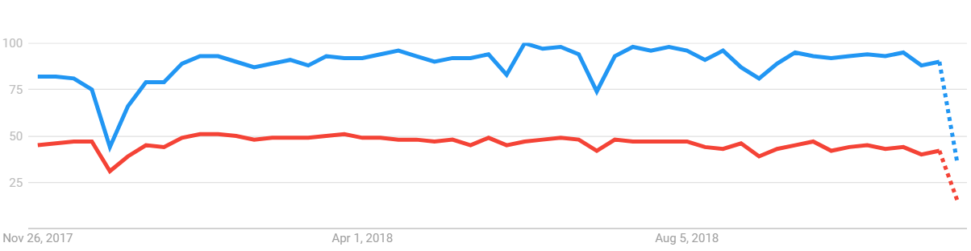
JSON,XML

Slide 75
Advice to data format standard designers
Don’t break JSON.
Make it signiﬁcantly better.
Get a better name.

Slide 76
JSON
Java-
Script
Object
Notation

Slide 77
Responsibility
0. The People
1. The Team
2. Management

Slide 78
And ﬁnally,
one piece of advice:
Don’t make bugs.

Slide 79
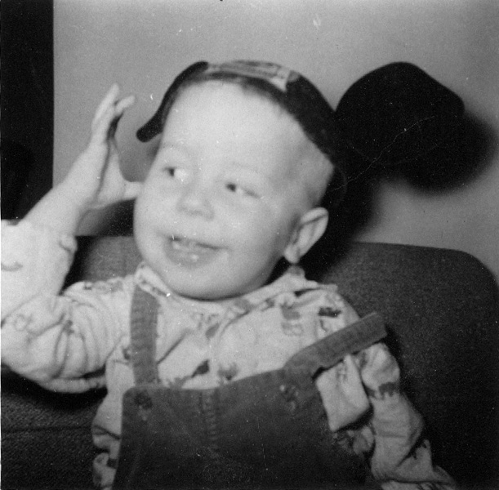
Thank you and good night.

