Slide 1
Weather-Based Outfit Suggestion App
Prepared by [Name]
Date: [Date]

Slide 2
Introduction
Overview of the Concept:
  Develop an application that combines real-time weather data with outfit suggestions.
Purpose:
  Helps users select weather-appropriate outfits for comfort, safety, and style.

Slide 3
Problem Statement
User Pain Points:
  Difficulty in choosing weather-appropriate outfits, especially with sudden weather changes.
  Checking weather manually and deciding wardrobe choices is inconvenient.
Market Need:
  Lack of personalized, weather-based outfit suggestion apps in the market.

Slide 4
Aim
Primary Aim:
  Develop an app that provides outfit suggestions based on real-time weather conditions and user preferences.

Slide 5
Objectives
Real-Time Weather Integration
User Preferences
Personalized Suggestions
Sustainability Focus
Accessibility and Convenience

Slide 6
Methodology
Weather Data Collection:
  Use APIs to get real-time weather.
Outfit Suggestion Algorithm:
  Match weather data with clothing choices.
User Profile & Preferences:
  Allow users to input preferences.
Machine Learning :
  For better personalization.
App Development and Testing:
  Use frameworks like Google Colab and Hugging Face

Slide 7
Application Steps
The following steps are involve in developing an application
  Model Selection (llama from Groq)
  API (groq and openweathermap)
  Google Colab
    For Testing
  Hugging Face
    For Deployment

Slide 8
App Work Flow
User Interface (UI)
  Home Screen: A welcoming screen where the user can sign in, set location, and see the current weather.
  Weather & Outfit Screen: Displays the current weather and recommended outfits based on user settings and location.
  Settings: Allows the user to set preferences, e.g., style, temperature sensitivity, favorite clothing items, etc.
  Wardrobe & Saved Outfits: Allows the user to view their wardrobe, save recommended outfits, or create custom looks.
Data Collection and Input
  Location Detection: Use GPS or user-provided location to get the user’s current city or region.
  Weather Data Retrieval: Integrate a weather API (e.g., OpenWeatherMap or Weatherstack) to fetch real-time weather data based on the location.
  Weather Information Needed: Temperature, humidity, wind speed, precipitation, etc.

Slide 9
App Work Flow
3. Weather Analysis
  Weather Classification: Based on weather data, classify conditions as hot, warm, cool, cold, rainy, windy, etc.
  Outfit Category Mapping: Map each weather category to general outfit categories (e.g., raincoat and boots for rain, light layers for warm weather).

Slide 10
App Work Flow
4. Outfit Recommendation Engine
  User Profile & Preferences: Store user information like style preferences, common color choices, temperature comfort range, and sensitivity (cold-tolerant or cold-sensitive).
  Outfit Database: A database containing clothing items, categorized by type (e.g., tops, bottoms, accessories) and weather suitability (e.g., jackets for cold, shorts for warm).
  Basic Filtering: Filter outfits by current weather, user preferences, and clothing availability.
  AI Outfit Suggestions : Use a machine learning model (like collaborative filtering or content-based filtering) to recommend specific items based on user behavior (e.g., past likes/dislikes).
  Styling Rules: Ensure suggested outfits meet basic styling rules (e.g., match colors, balance formality).

Slide 11
App Work Flow
5. Analytics & Improvement
  Usage Analytics: Track outfit suggestions, user feedback, and frequently selected items to analyze trends.
  Model Retraining (if using AI): Periodically retrain the recommendation model based on accumulated data to refine outfit suggestions

Slide 12
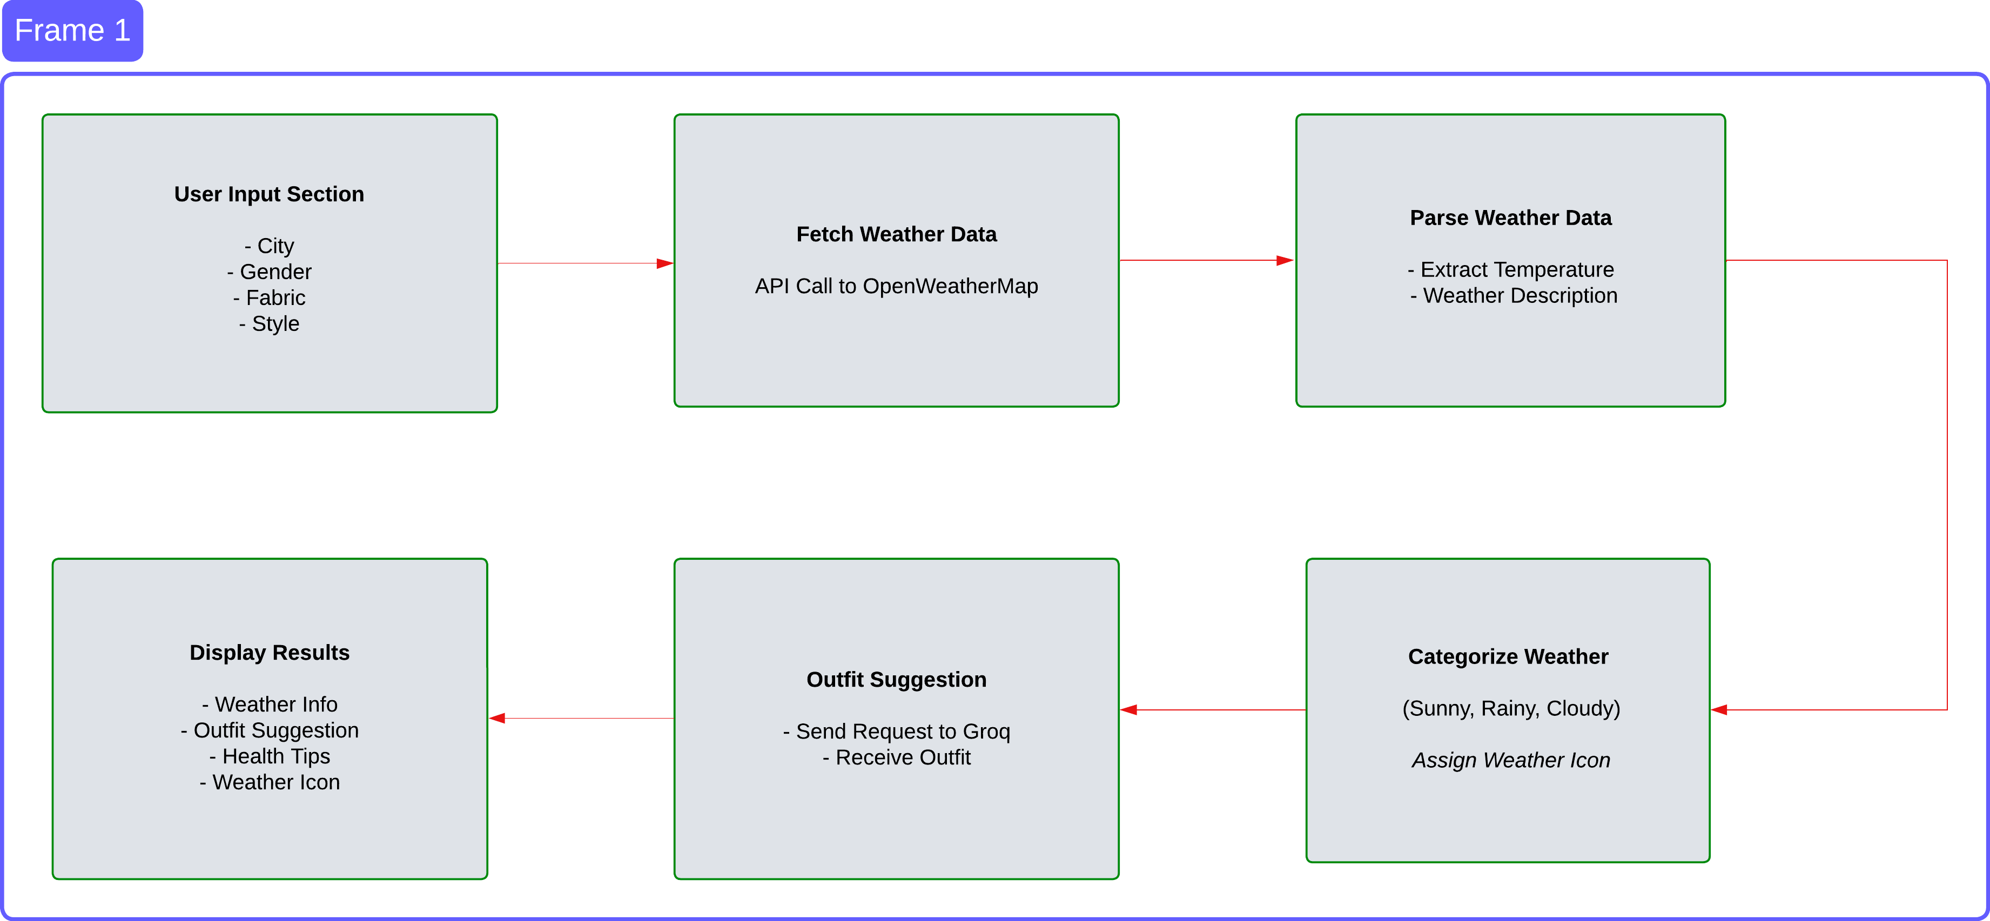
App Work Flow

Slide 13
Application
User Journey:
  Displays app flow from weather data input to outfit suggestions.
Example Scenarios:
  Outfit suggestions for rain, snow, sunny, and windy conditions.
User Interface:
  Highlights unique features like notifications and fashion trends.

Slide 14
Benefits
Time-Saving
Comfort and Safety
Sustainable Fashion Encouragement
Improved User Satisfaction

Slide 15
Conclusion
Summary:
  Design an application that integrates real-time weather data to provide customized outfit recommendations.
  Helps users select weather-appropriate outfits for comfort, safety, and style.
Future Plans:
  Potential for features like social sharing, wardrobe integration, and a virtual closet.
Closing Statement:
  Emphasizes the app’s role in enhancing daily experiences by integrating technology, fashion, and weather insights.

Slide 16
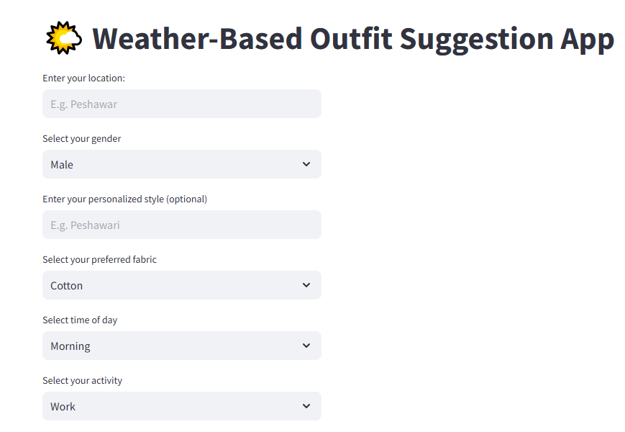

Slide 17
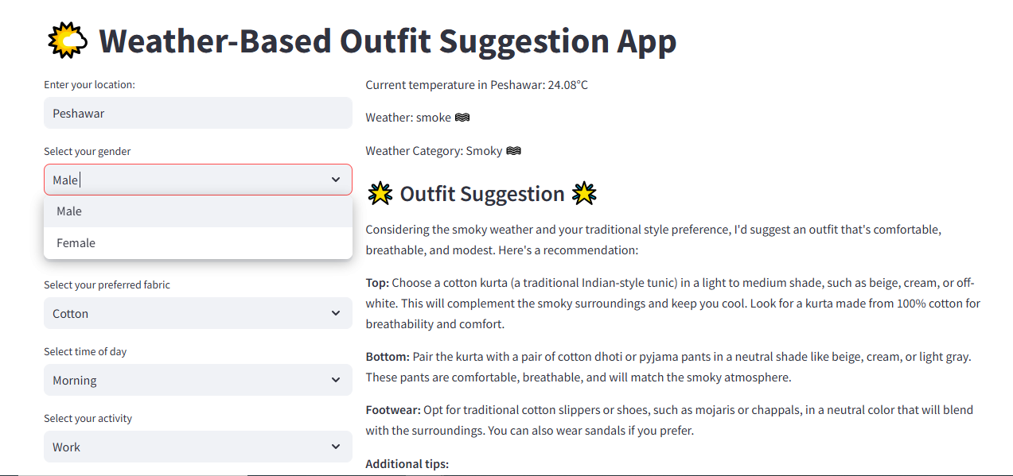

Slide 18
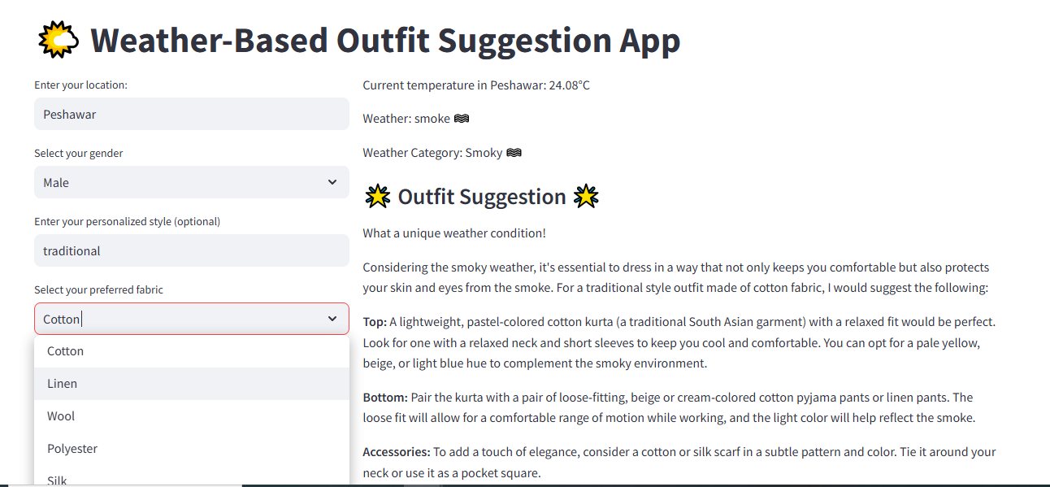

Slide 19
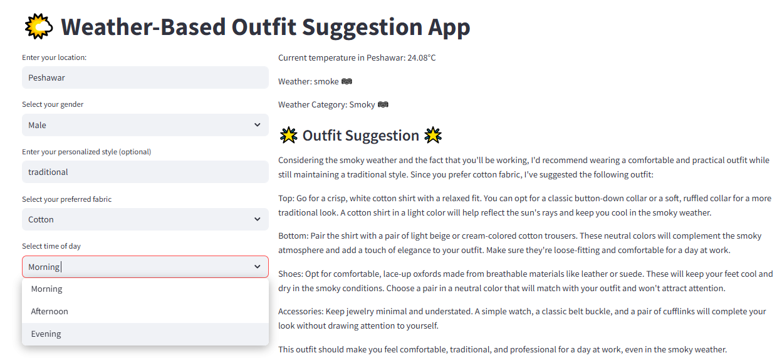

Slide 20
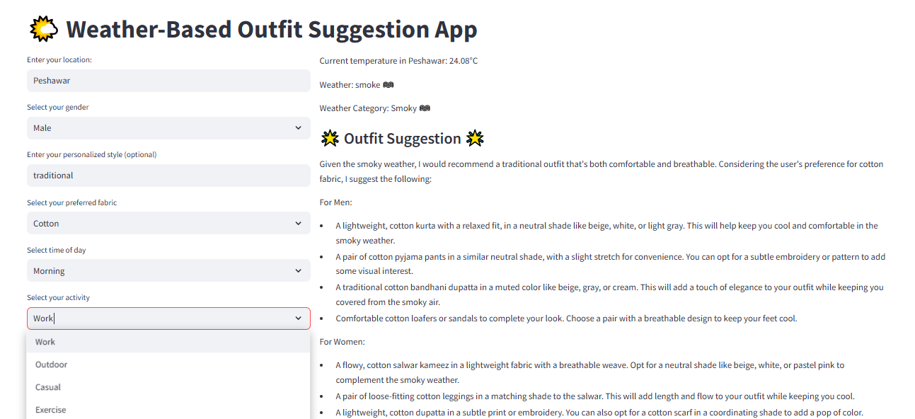

Slide 21
THANKS

