Slide 1
Enhancing Foundation Models Through Interaction
Speaker: Wenhu Chen

Slide 2
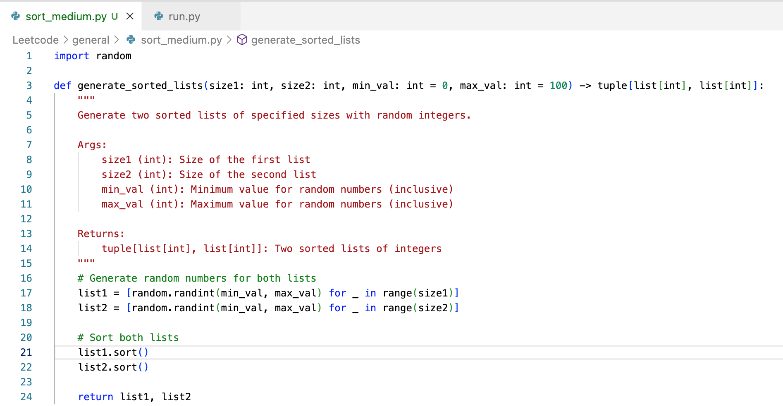
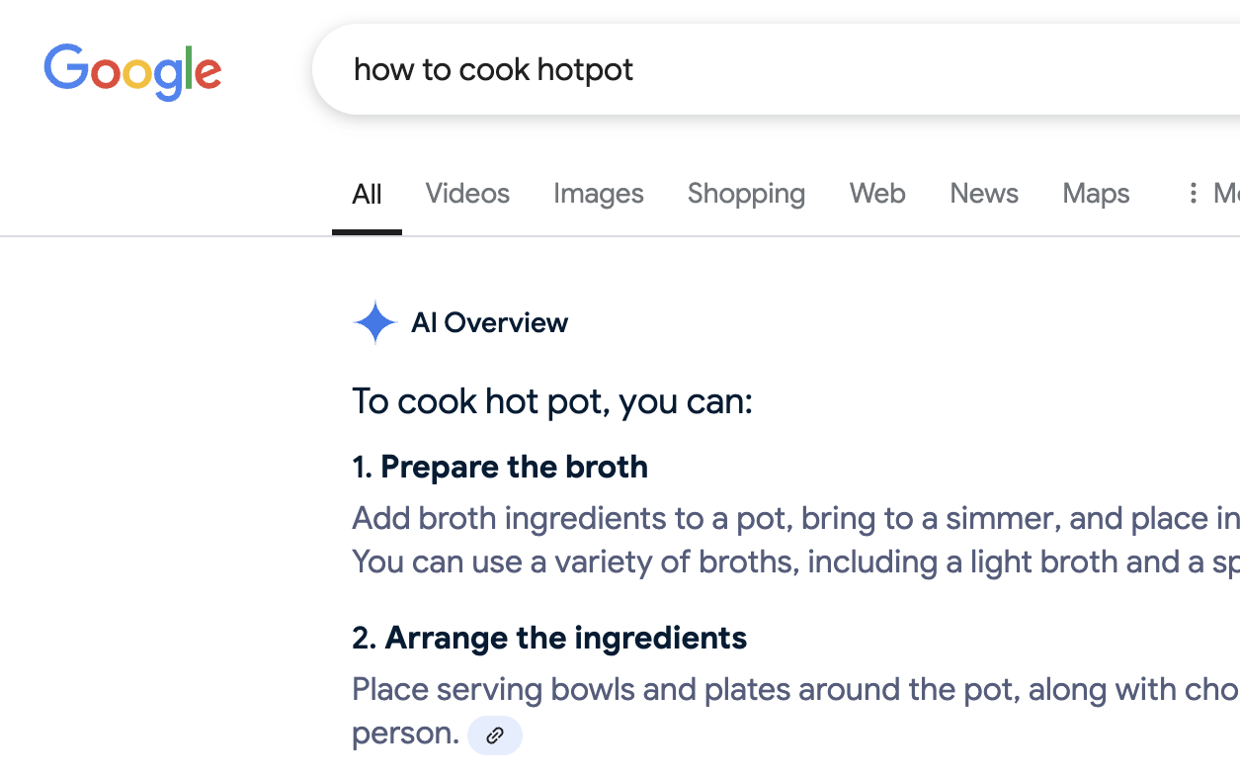
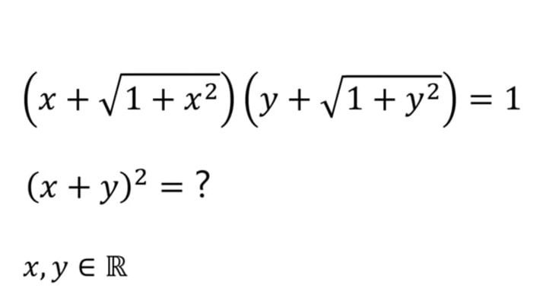
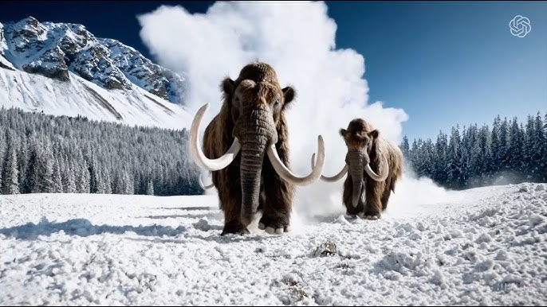
Foundation Models
Creative Writing
Coding
Information Seeking
Mathematics
Image Generation
Video Generation
Notes:
The field of AI has seen remarkable progress over the recent years. Foundation model is the core of this transformation. Many well-known foundation models including ChatGPT, Gemini, Claude, DeepSeek AI has shown general reasoning capabilities, allowing them to be used across diverse set of tasks. These models power creative writing, coding, mathematics, information retrieval, image and video generation.

Slide 3
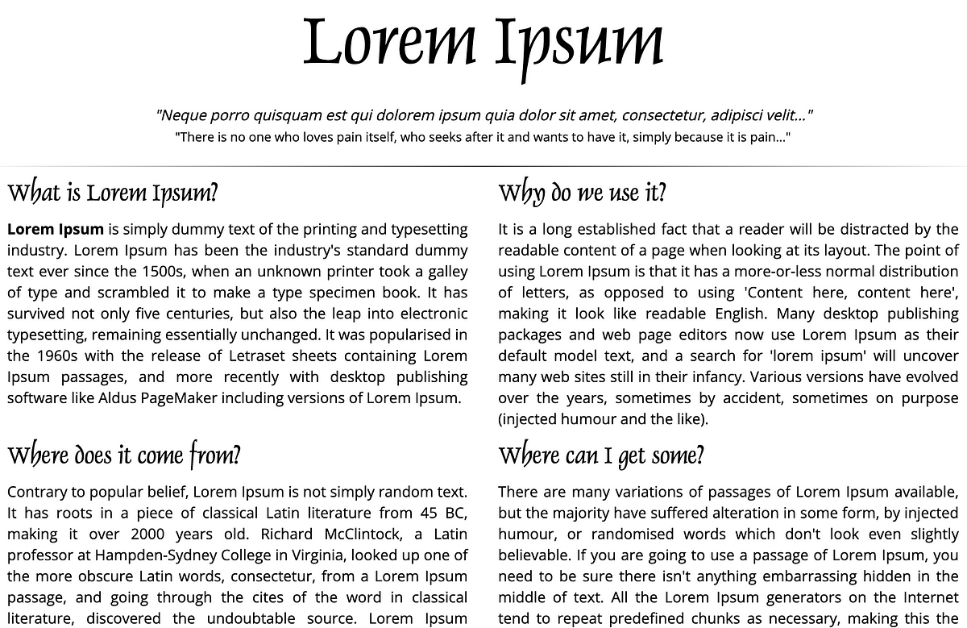
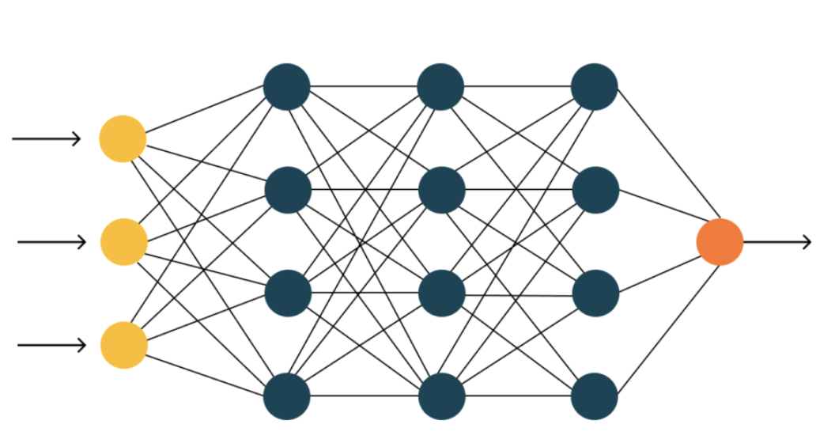
The Success of Foundation Models
Trillion tokens
training
Foundation Model
Notes:
The success of foundation models comes from massive-scale training on diverse dataset. These models learn from trillions of tokens sourced from Wikipedia, arxiv, stack overflow, etc, enabling broad generalization. Advanced architectures like transformers allow them to have enough capacity to internalize such enormous amount of knowledge encapsulated in the data.

Slide 4
Training: Fitting Data Distribution
$$p_{θ}(x)$$
training
Parameters: $θ$
$$D_{seen}$$
MLE Loss:
$$arg\max_{θ} \sum_{x\sim D_{seen}}{\log{p_{θ}(x)}}$$
Notes:
Let’s look at how these models are being trained. Let’s define two notions, D_seen is the training data and p_\theta is the parameterized distribution. The model learns to fit the real-world data during the training process. This training is achieved through maximum likelihood estimation, where the model maximizes the probability of observed data by adjusting the parameters theta.

Slide 5
Inference: Sampling from Learned Distribution
Is this desirable?
Observed data is only an abstraction of deeper human thinking, reasoning, interactions. Imitating the data does not necessarily teach models these underlying skills.
$${\hat{x} \sim p}_{θ}\left(x\right)$$
Notes:
When the training is complete, the data can be discarded. The model’s learned distribution p theta serves as an approximation of the original data distribution. This allows the model to generate outputs like humans purely from its parameters without accessing the training data. However, is this desirable? While the model captures the surface-level patterns, data itself is only an abstraction of deeper human thoughts, reasoning, and interactions that occur beneath.

Slide 6
Hallucination (mathematics)
Question: What is 100 + 222?
In-distribution
The result of 100 + 222 is 322
Question: What is 8432 * 3391?
The result of 8432 * 3391 is 28,567,792.
Out-of-distribution
Question: What is the 50th number in Fibonacci sequence?
The first number is 0, the second number is 1, therefore, the third number is 0+1=1. After some iteration, the 50th number is 32,432,268,459.
Notes:
The models are making mathematical errors. It fits the seen computation pretty well but falls short out of the distribution.

Slide 7
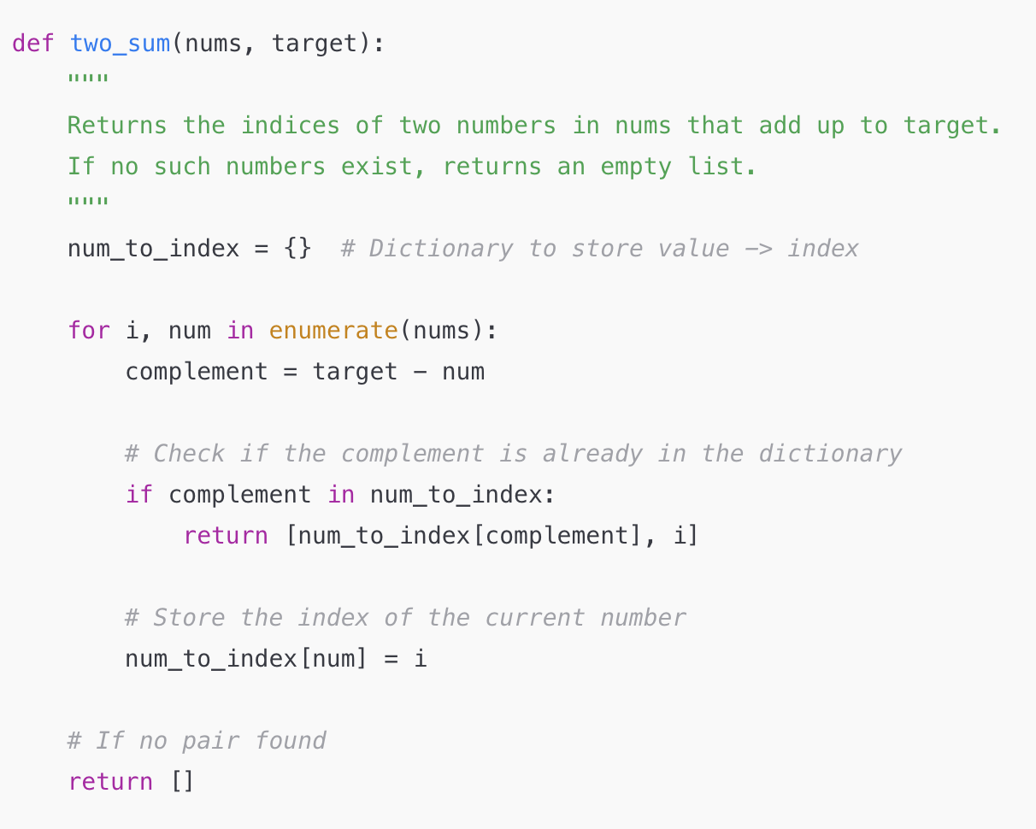
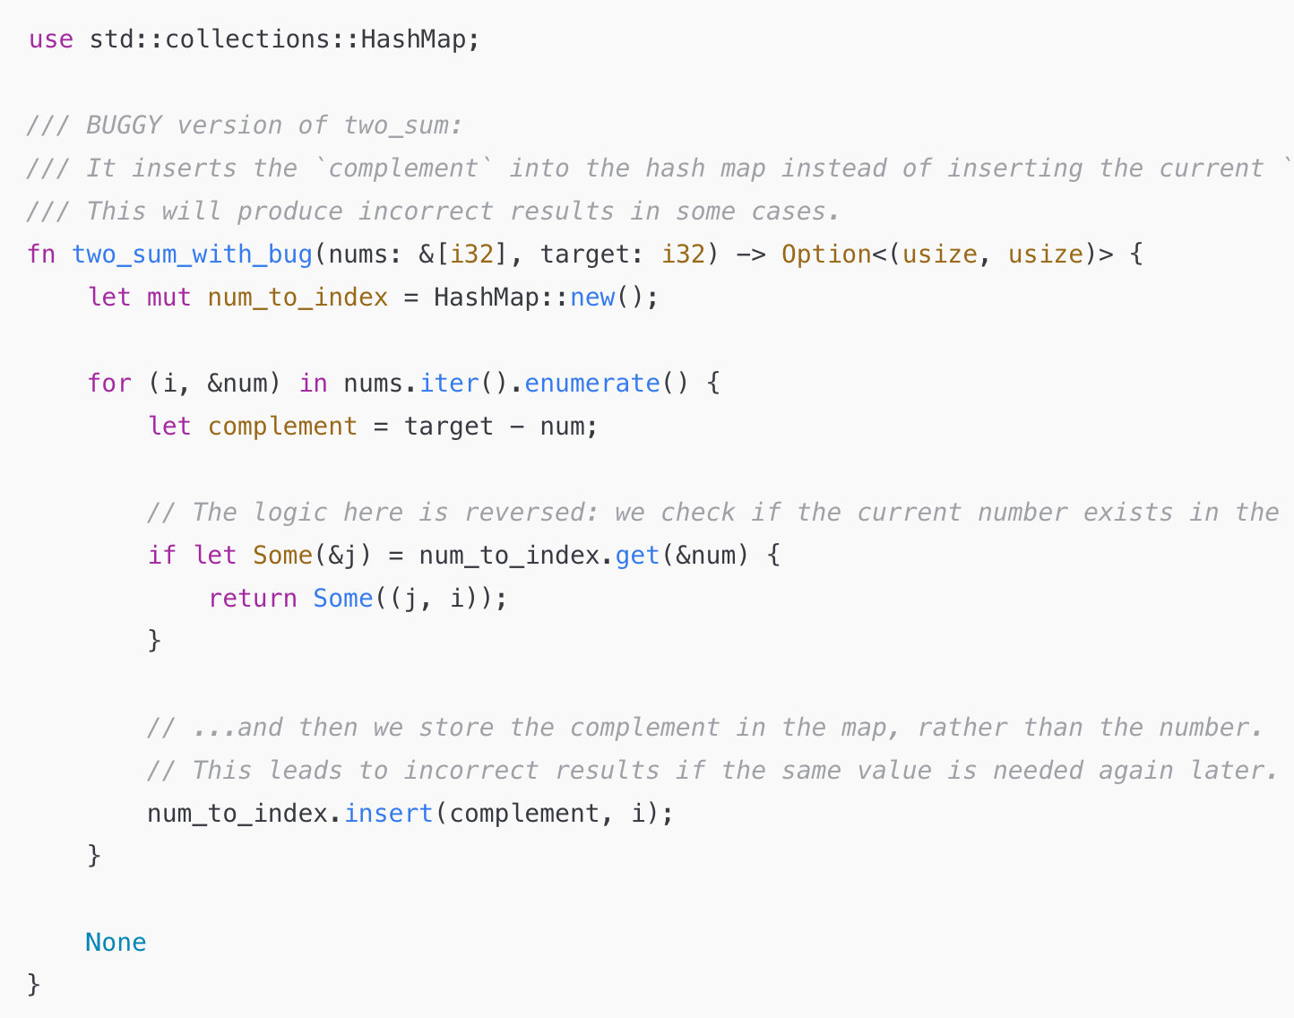
Hallucination (coding)
In-distribution
Out-of-distribution
Question: Can you write the Python program to solve the two-sum problem?
Question: Can you write the Rust program to solve the two-sum problem?
Notes:
Similarly, these foundation models are also making lots of factual errors.

Slide 8
Why is LLM Hallucinating?
Why is Hallucination happening?
The model doesn’t understand how the data was generated,
It only learns to fit the surface-form of the data!
Notes:
Why is LLM prone to hallucination? The main reason is because the model only learns to fit the data surface form without understanding how the data is generated. This makes the model highly prone to errors for out-of-distribution inputs.

Slide 9
What’s Data Generation Process
Financial Report
Github Program
generation
Notes:
Let’s look at how humans generate the data by looking into two examples regarding financial report and Github program.

Slide 10
Invisible Interaction in Writing
Financial Performance
Annual Revenue: NVIDIA reported a revenue of $60.9 billion for fiscal year 2024, marking a 126% increase from the previous fiscal year.
Net Income: The company's net income for 2024 was $29.76 billion, a significant rise from $4.37 billion in 2023.
Earnings Per Share (EPS): GAAP EPS stood at $11.93, up 586% from the prior year, while non-GAAP EPS was $12.96, reflecting a 288% increase.
Quarterly Highlights
Q1 FY2025: Revenue reached $26.0 billion, an 18% increase from the previous quarter and a 262% surge year-over-year.
What’s the revenue of NVIDIA for fiscal year 2023?
26.94 billion
126%
generate
Notes:
Suppose we see a financial report stating that NVDIA’s revenue for 2024 has 126% increase from last year. How was the information actually generated? First, the analyst will query the internet over past financial data to know the revenue was 26.94$ billion, and then they will compute the percentage increase with a calculator to get 126%. This illustrates that the data generation process invokes a lot of interaction and reasoning with the external environment.

Slide 11
Interaction is Invisible in the Seen Data
$$x_{gen}$$
$$x_{seen}$$
$$arg \max_{θ} log{p\left(x_{1},x_{2},x_{6},x_{8}\right) }$$
Notes:
A key limitation of the models is that they only maximize the likelihood of the observable part of the data without understanding the underlying generative process.
As shown here, the generation process invokes lots of interaction with other tools. However, when training the foundation models, we only maximizes the observable part without considering underlying generation process.

Slide 12
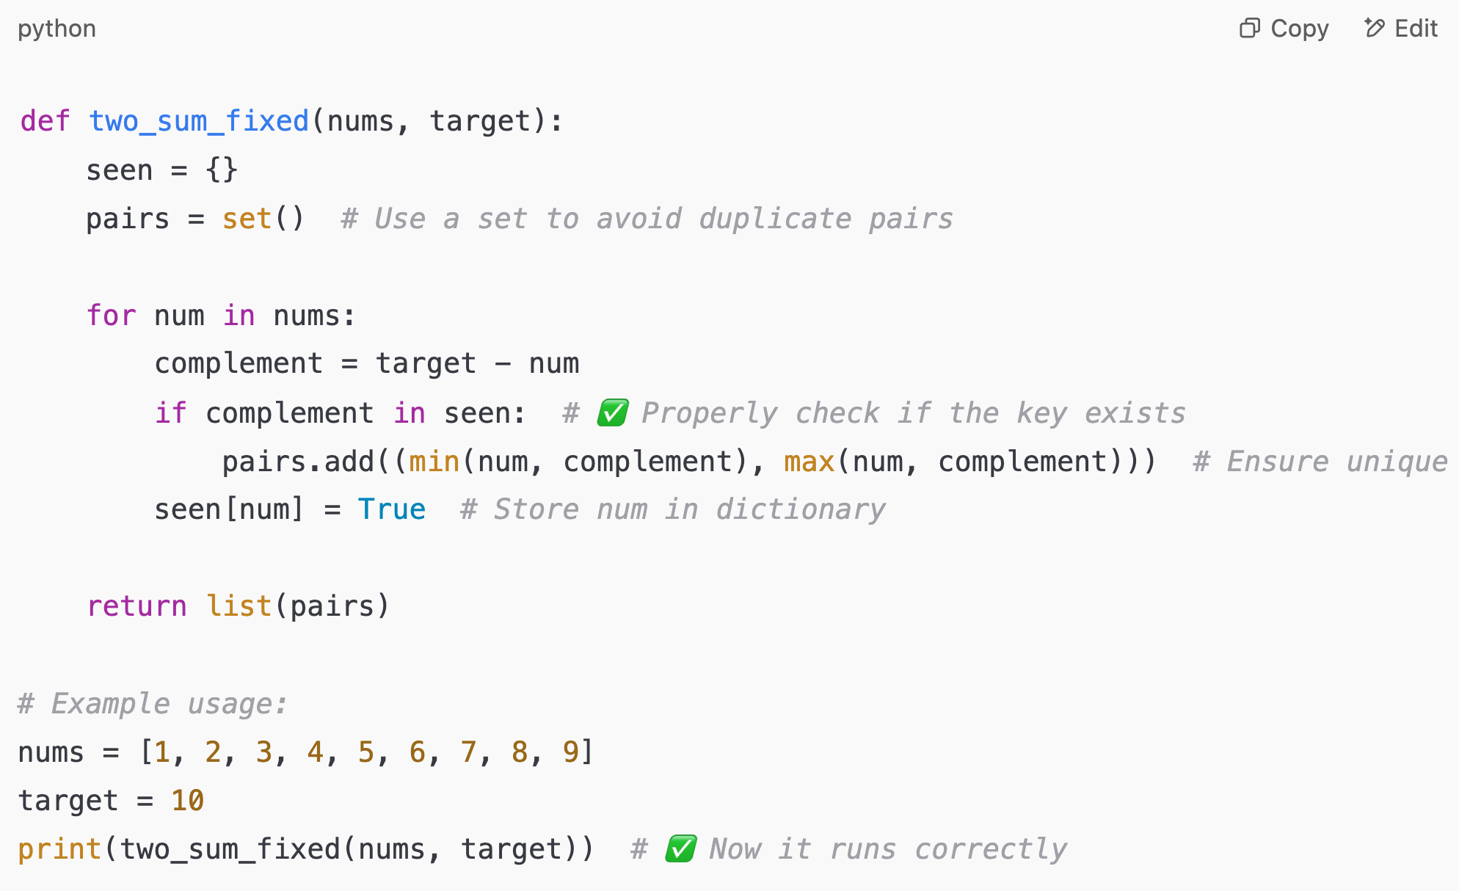
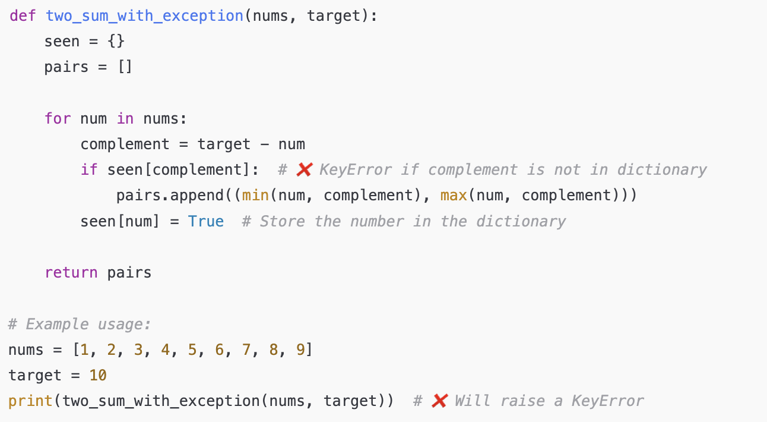
Invisible Interaction in Coding
Debug
Test Case 1
Test Case 2
Test Case 3
generate
Notes:
Similarly, when programmers are writing code, they will debug for multiple rounds to generate the program.

Slide 13
Interaction is Invisible in the Seen Data
$$x_{gen}$$
$$x_{seen}$$
$$arg \max_{θ} log{p\left(x_{6},x_{7},x_{8}\right) }$$
Notes:
Similarly, the debugging process is not shown in the observable training data. If you crawl the data from Github, you are only the end program, which is the outcome of the interaction.

Slide 14
Foundation Models are Non-Interactive
$$arg \max_{θ} log{p\left(x_{seen}\right) }$$
search
calculator
interpreter
database
python
translation
Without interaction, the model can’t ground its information, thus prone to hallucination.
simulator
system

Slide 15
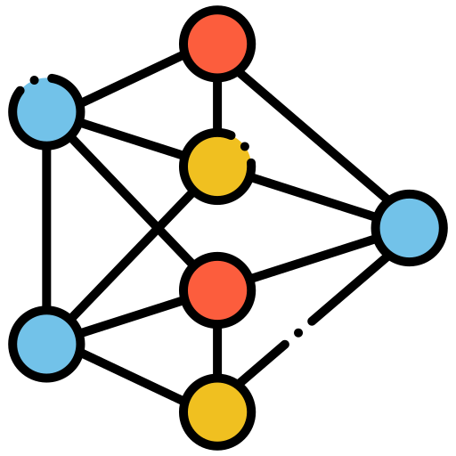
Training Models to Interact with the World!
1
Imitation Learning from simulated interactive trace
Fitting
2
Reinforcement Learning from verifiable reward
sample

Slide 16
Talk Outline
Section 1: Math
Interacting with Python Tools
Section 2: Coding
Interacting with Executor and Humans
Other Work
Evaluation & Multimodal & RAG
Future Work
Notes:
In this talk, I will cover two sections in math and coding to talk about how to teach foundation models how learn the interactive data generative process.

Slide 17
Talk Outline
Section 1: Math
Interacting with Python Tools
Section 2: Coding
Interacting with Executor
Other Work
Evaluation & Multimodal & RAG
Future Work
Notes:
In this talk, I will cover two sections in math and coding to talk about how to teach foundation models how learn the interactive data generative process.

Slide 18
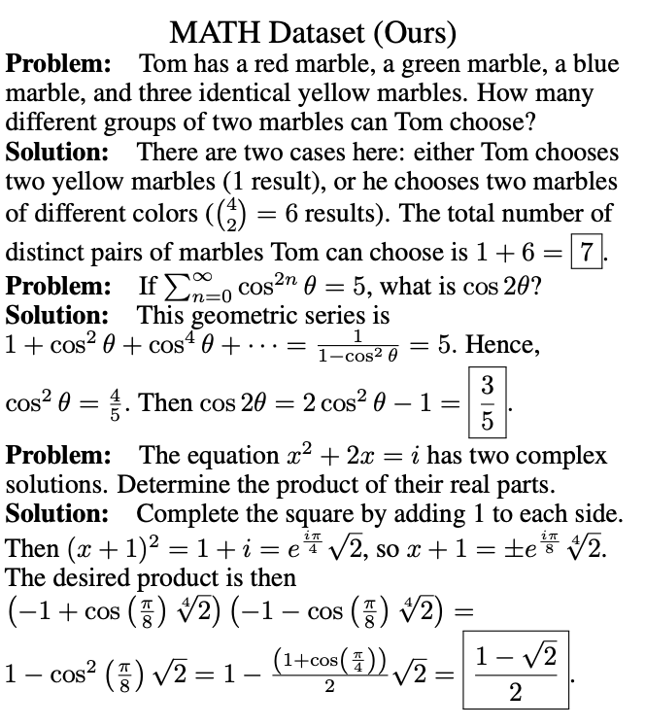
Background: LLM Reasoning
Exams
Notes:
The task we are focusing on is the question answering, where the questions are coming from various exams like American math competition, GRE, etc.

Slide 19
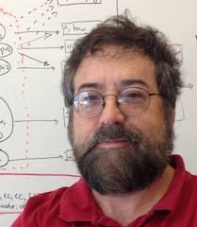
Prompt Language Models to Interact with Tools
Program of Thoughts Prompting : Disentangling Computation from Reasoning for Numerical Reasoning Tasks
TMLR 2022
Chain of Thought
Query
Program Execute
Notes:
This first part is based on the program of thoughts paper.

Slide 20
ChatGPT in mid 2022
Question: In Fibonacci sequence, it follows the rule that each number is equal to the sum of the preceding two numbers. Assuming the first two numbers are 0 and 1, what is the 50th number in Fibonacci sequence?
The first number is 0, the second number is 1, therefore, the third number is 0+1=1. Therefore, the 50th number is 32,432,268,459.
No interactive thinking process!
Notes:
This was me prompting ChatGPT to answer what’s the 50th number in Fibonacci sequence in 2022. ChatGPT was very impatient and gave me the answer directly without too much thinking.

Slide 21
Elicit Interaction with Prompting
ChatGPT
inp
out
How can we elicit the model to perform interaction through prompting?
Notes:
Due to the lack of interacting reasoning process, GPT-3 or Codex in 2022 are still way behind human experts on solving high school math problems. At that time, we were thinking that: maybe these models already know how to perform interactive reasoning, it’s just that we didn’t use the right way to prompt it.

Slide 22
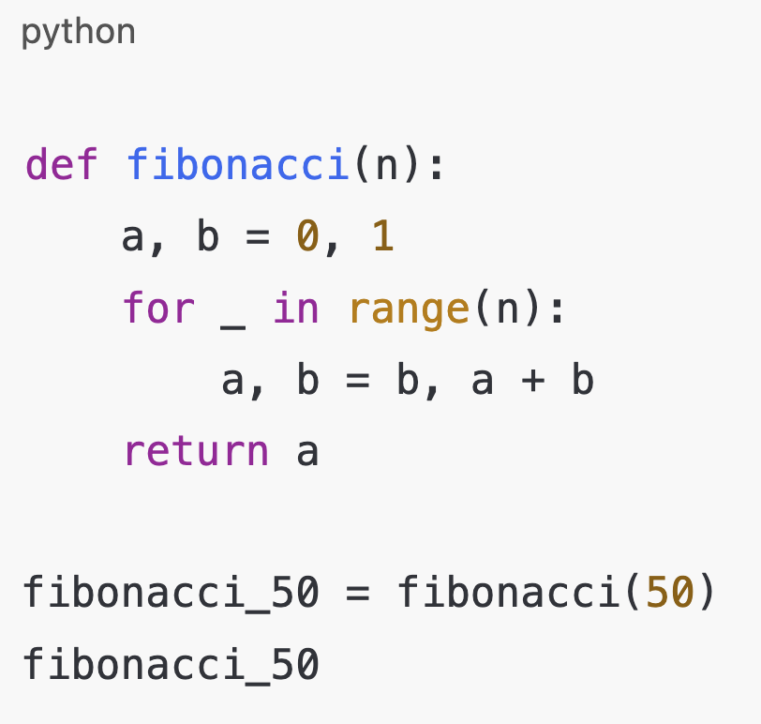
Program-of-Thought Prompting
Question: In Fibonacci sequence, it follows the rule that each number is equal to the sum of the preceding two numbers. Assuming the first two numbers are 0 and 1, what is the 50th number in Fibonacci sequence?
The first number is 0, the second number is 1, since this computation goes for 50 steps, let’s invoke Python;
1-shot
example
12586269025
Therefore, the answer is 12586269025.
Question: What is the ….?
In the question … let me invoke Python ….
Notes:
That’s why we propose the new approach called program-of-thought prompting, where we give an example of how to think and invoke python tool in the middle to solve the math problem.

Slide 23
Experimental Results of PoT
Oct 2022
High School Math
Table Reasoning
Finance
Notes:
We evaluated our prompting approach and saw dramatic improvement across benchmarks in math, table reasoning and finance. For example, on MATH dataset, we got 17% improvement. On Finance QA, we got 24% improvement. These massive improvement indicates that these models already know how to perform interactive reasoning to a certain extent.

Slide 24
Impact of PoT (OpenAI CodeInterpter)
Notes:
PoT has been quite popular after it has been published. 1 year after it’s published, it’s been integrated into the OpenAI codeinterpreter.

Slide 25
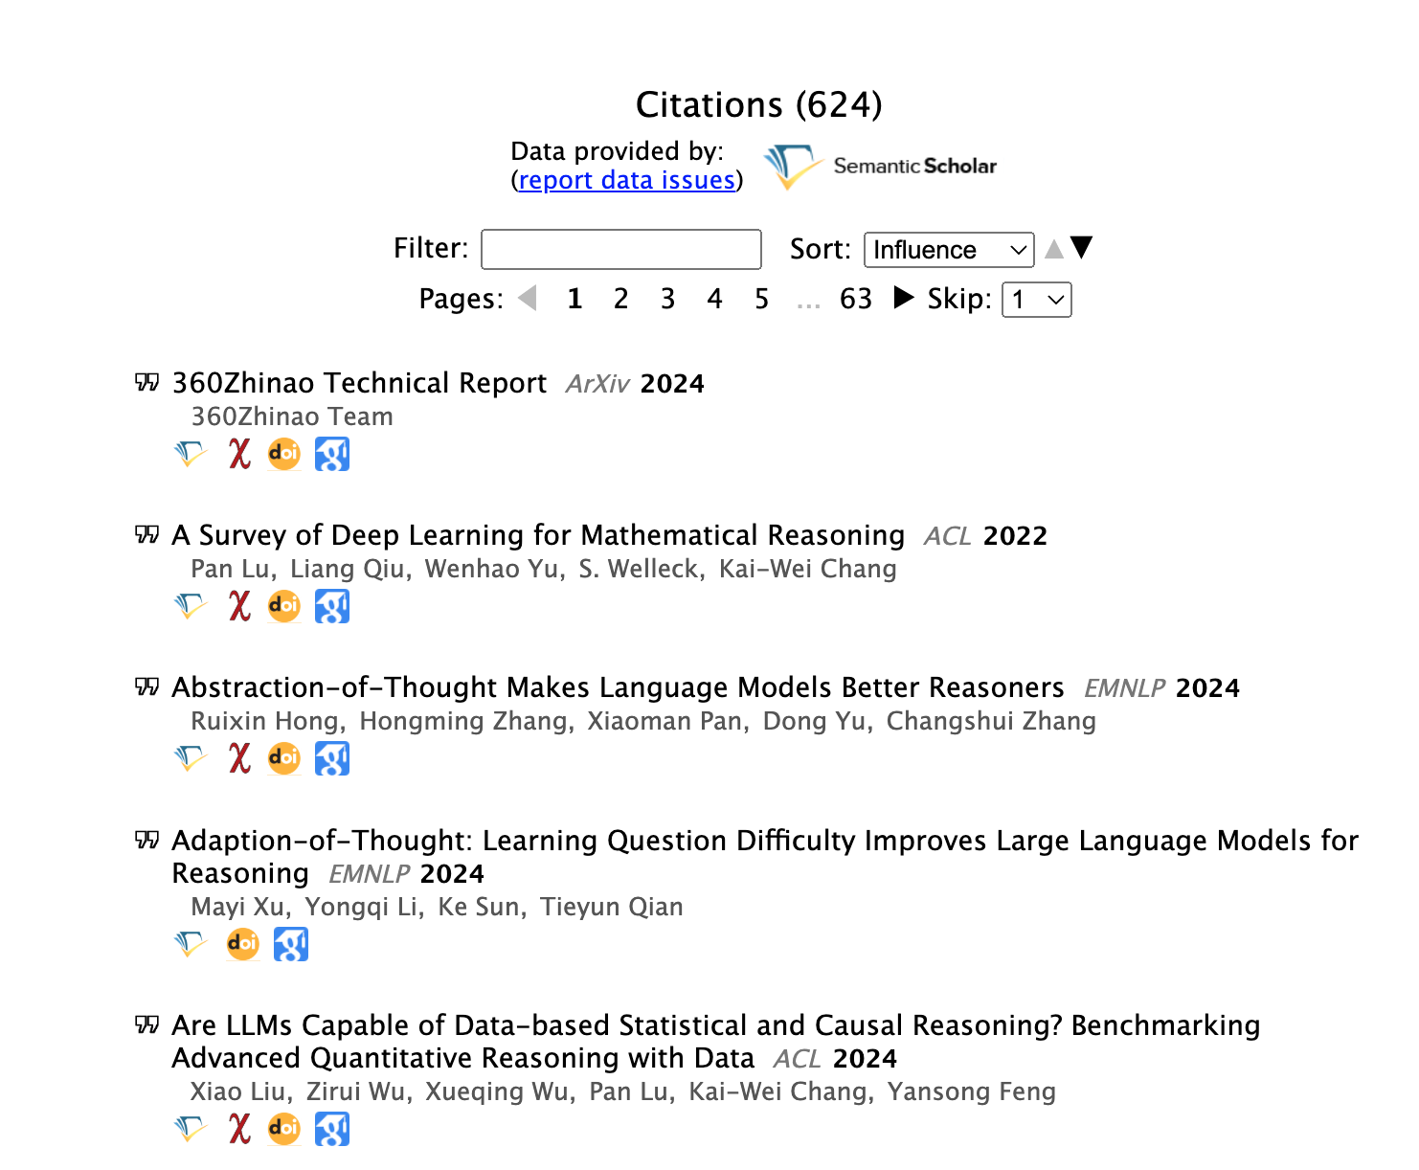
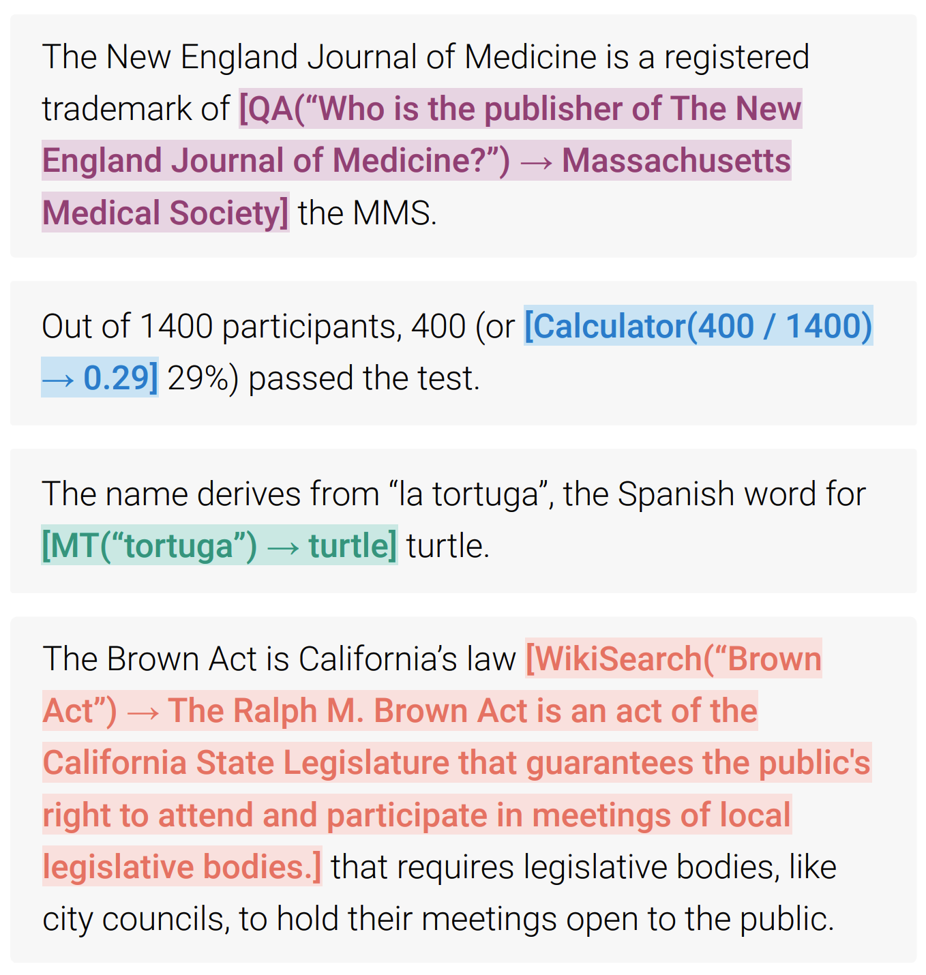
Impact of PoT (Beyond Math)
Machine Translation System
Wikipedia Search
QA System
Notes:
The impact of PoT also goes beyond math. Two Meta papers have greatly expanded PoT to use other tools like MT system or Wikipedia Search in the generation process to improve generation.

Slide 26
Teaching Language Models to use Tools
MAmmoTH: Building Math Generalist Models through Hybrid Instruction Tuning
ICLR 2024 (Spotlight)
Chain of Thought
Query
Program of Thought
Notes:
Then we will cover the next paper on MAmmoTH.

Slide 27
Open Models can’t do PoT
Aug 2023
Let’s teach open models how to interact with tools by simulating the interactive traces!
53%
Notes:
One year after PoT was released, we found that the open models are still struggling with PoT. Their gap with GPT-4 is still as significant as 50%. Therefore, we decide to teach these models to do interactive reasoning by creating a new dataset.

Slide 28
Simulated Interactive Traces (MathInstruct)
Ans
== 2036501074
thinking
program
exec
Ans
$≠$ 2036501074
thinking
program
exec
In Fibonacci sequence, it follows the rule that each number is equal to the sum of the preceding two numbers. Assuming the first two numbers are 0 and 1, what is the 50th number in Fibonacci sequence?
Ans
$≠$ 2036501074
Answer: 2036501074
thinking
program
exec
Notes:
The basic idea is very simple, we feed a human-annotated question to GPT-4 to let it generate several PoT traces. We then compare the results of these PoT traces and compare with human-annotated answers to perform rejection sampling.

Slide 29
Imitation Learning on MathInstruct
Ans
$$arg \max_{θ} log{p(x_{gen})}$$
In Fibonacci sequence, it follows the rule that each number is equal to the sum of the preceding two numbers. Assuming the first two numbers are 0 and 1, what is the 50th number in Fibonacci sequence?
Notes:
With MathInstruct dataset, we were able to train the model with the entire interactive reasoning trace to help it understand the actual data generation process.

Slide 30
Experimental Results
28%
23%
State-of-the-art!
our training
our training
Notes:
We observe that our model can achieve more than 20% improvement on both the 7B-parameter model and 34B-parameter model.

Slide 31
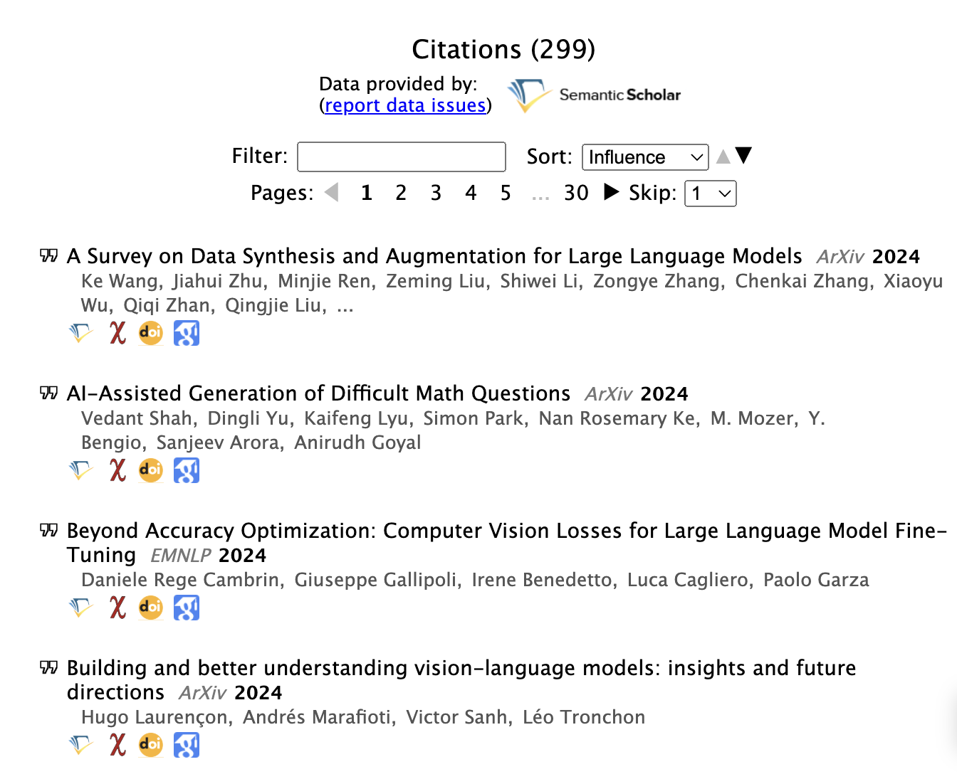
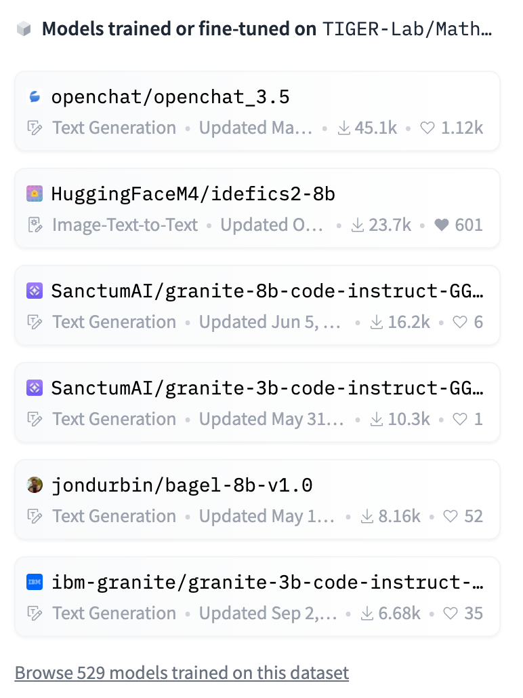
Impact of MAmmoTH (Huggingface)
529 models trained on MathInstruct
Notes:
MAmmoTH has amassed close to 300 citations. Our released dataset MathInstruct has been used to support more than 500 models on Huggingface. The most notable work is the DeepSeekMath, which adopts our dataset during the post-training stage.

Slide 32
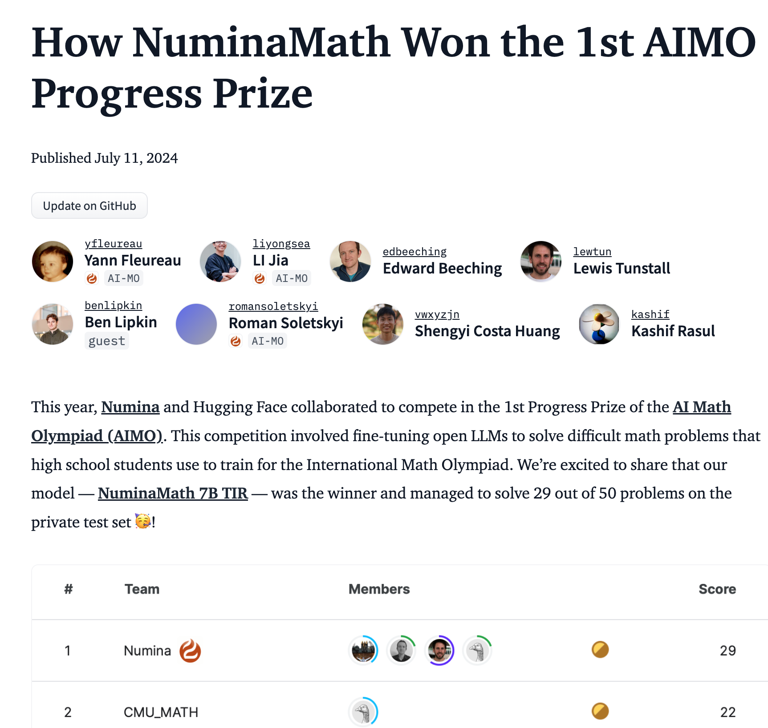
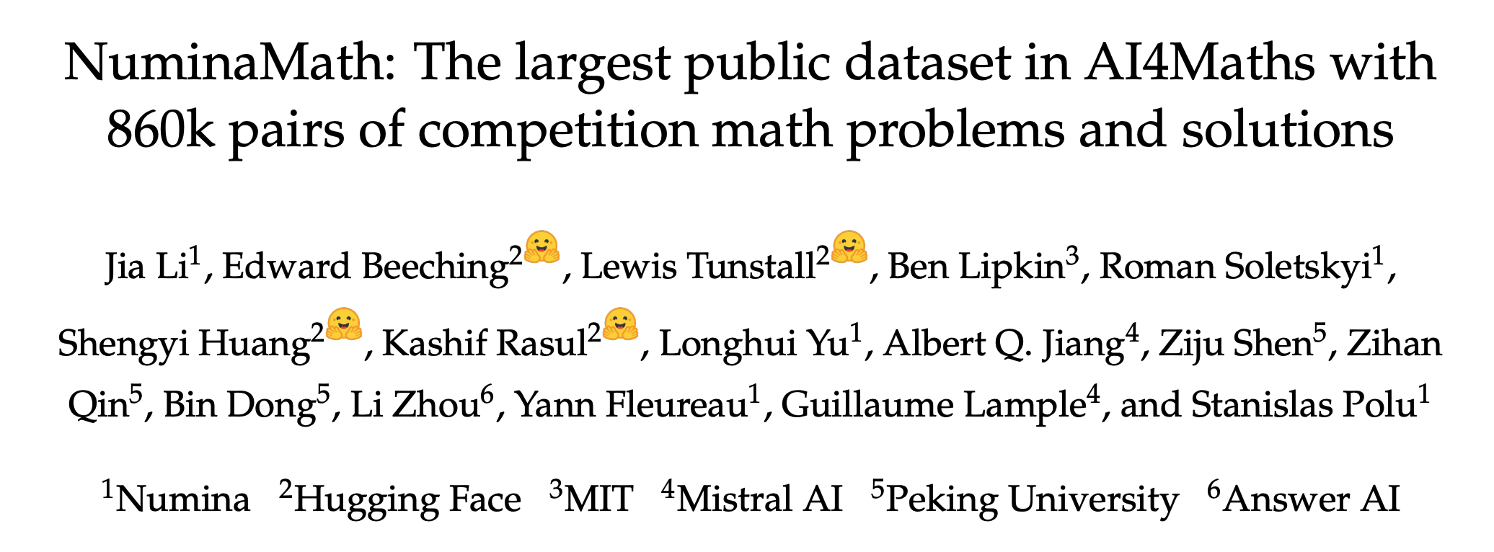
Impact of MAmmoTH (AI Math Olympiad)
Notes:
MAmmoTH’s data generation pipeline has also been adopted by NuminaMath, which is the gold medalist of AI Math Olympiad in 2024.

Slide 33
Talk Outline
Section 1: Math
Interacting with Python Tools
Section 2: Coding
Interacting with Executor
Other Work
Evaluation & Multimodal & RAG
Future Work
Notes:
In this talk, I will cover two sections in math and coding to talk about how to teach foundation models how learn the interactive data generative process.

Slide 34
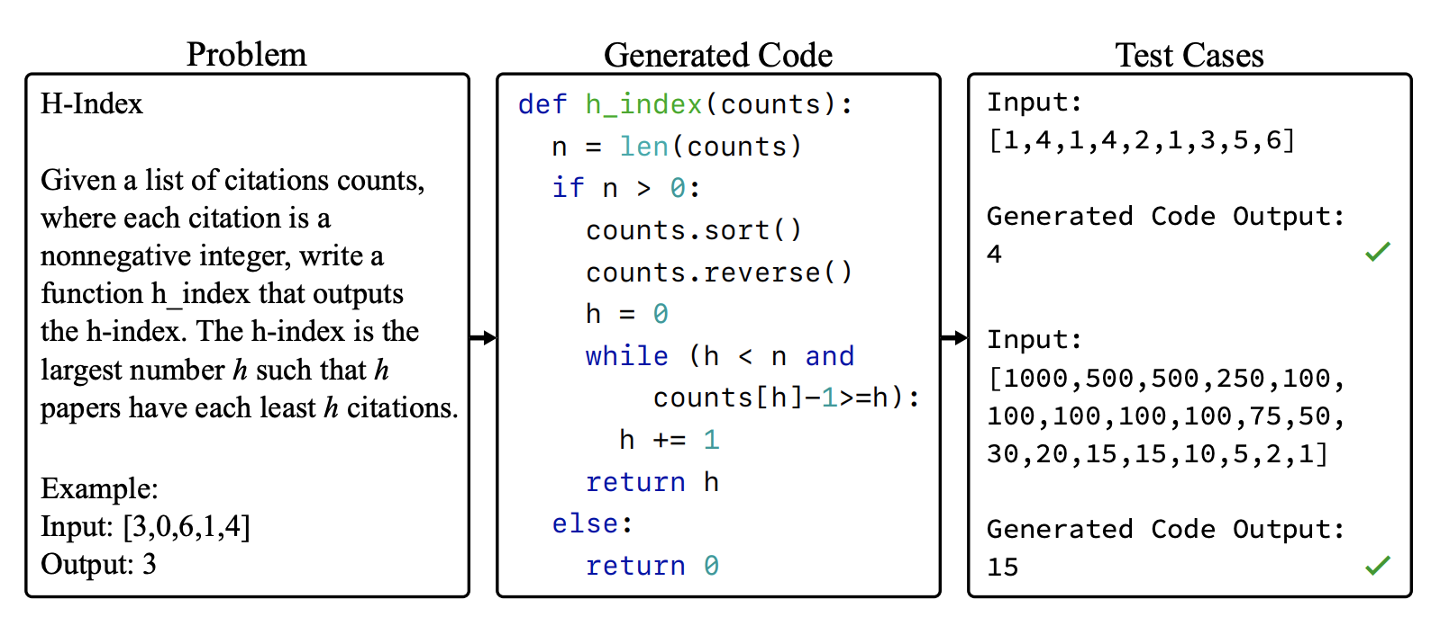
Background: Code Generation
Code Completion
Code Synthesis
Function + DocString -> Program
Language Instruction -> Program
Notes:
The task we are tackling is code completion and code synthesis. In these tasks, we are given a function+doc string to synthesize the program, or we are given an instruction to synthesize the program. These tasks are mostly evaluated by public test cases like Leetcode.

Slide 35
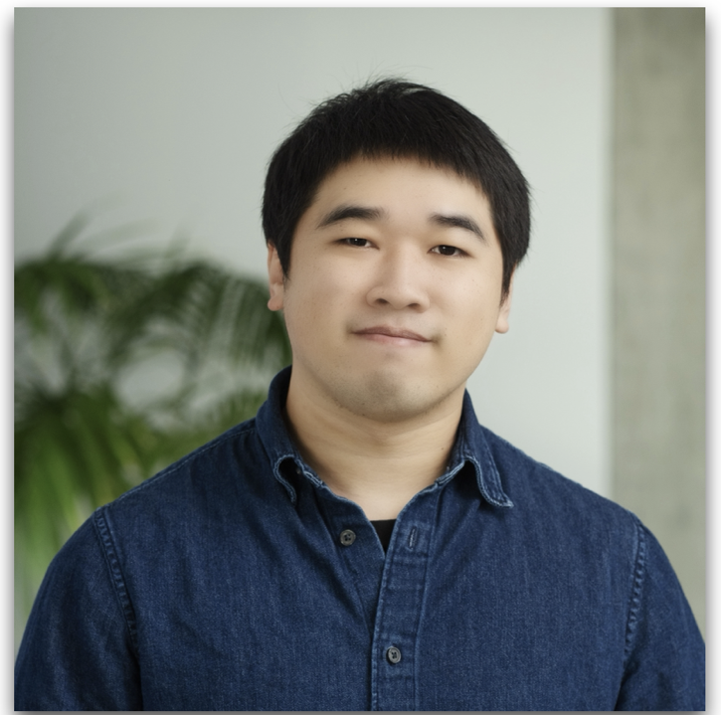
Teaching Coders to Interact with Executor and Humans
OpenCodeInterpreter: Integrating Code Generation with Execution and Refinement Findings of ACL 2024
Coder
feedback
Notes:
First, we will cover the paper on OpenCodeInterpreter.

Slide 36
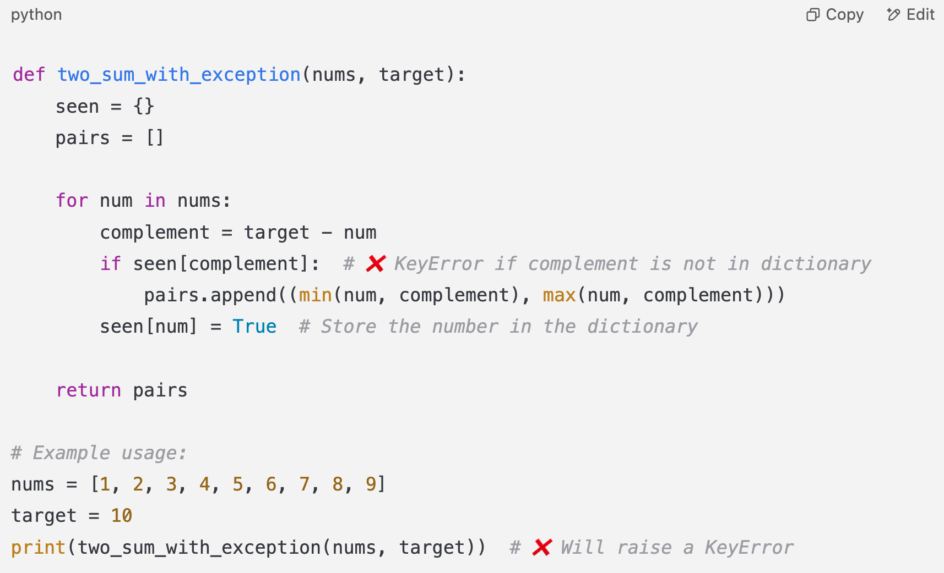
Coding is a Highly Interactive Task
Given an array of integers and a target sum, find all unique pairs of numbers that add up to the target sum. You should not use the same element twice in a pair. Return the list of unique pairs.
Notes:
As we all know, coding is a highly interactive task, which requires lots of interaction with the executor or search engine to understand the problem.

Slide 37
Coding is a Highly Interactive Task
Given an array of integers and a target sum, find all unique pairs of numbers that add up to the target sum. You should not use the same element twice in a pair. Return the list of unique pairs.
Test Case 1
Test Case 2
Test Case 3
Notes:
After a lot of interactions, the coder finally identifies the problem and pass the test cases.

Slide 38
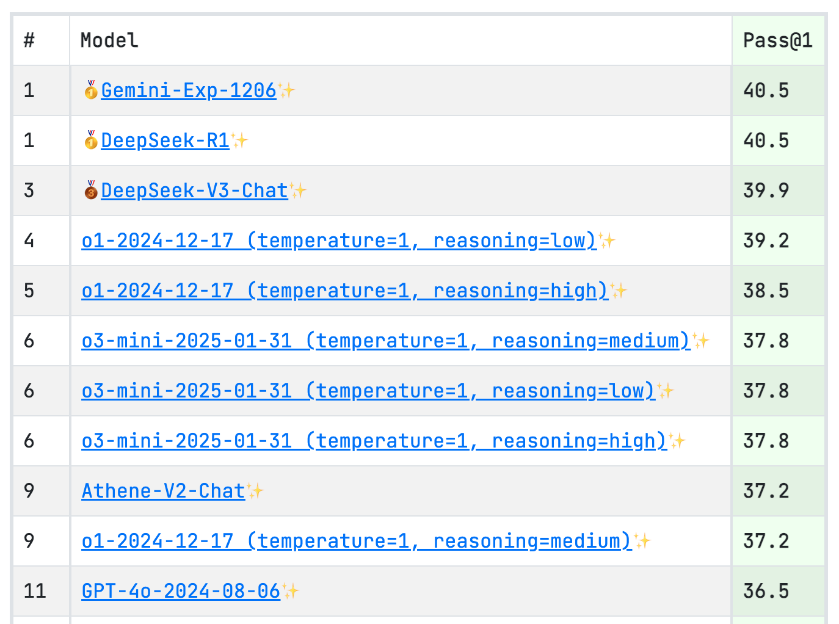
Pass@1 Evaluation
Notes:
However, the existing models and benchmarks are still heavily on pass@1.

Slide 39
Open Models can’t Self-Improve
Late 2023
Let’s teach open models how to interact with executor or humans by simulating the interactive trace!
Error Message
No improvement!
Coder Models
The algorithm didn’t cover the corner case when n=0, please improve the code to cover that. Otherwise, it won’t pass the tests.
Notes:
In late 2023, we tried to use these coder models to do self-improve or self-debug. However, we saw no improvement because these models haven’t been trained to utilize the interaction feedback.

Slide 40
1. Simulating Interaction with Executor
Given an array of integers and a target sum, find all unique pairs of numbers that add up to the target sum. You should not use the same element twice in a pair. Return the list of unique pairs.
Refine
Notes:
We started from a weaker model like GPT-3.5, which makes a lot of mistakes in the first pass. We feed the error message to the GPT-4 and ask GPT-4 to refine it.

Slide 41
1. Simulating Interaction with Executor
Given an array of integers and a target sum, find all unique pairs of numbers that add up to the target sum. You should not use the same element twice in a pair. Return the list of unique pairs.
Notes:
We conduct the refinement for multiple rounds until GPT-4 believes that the solution is correct. At that time, the dataset we were using doesn’t have test cases available, so we basically adopt gpt-4 as the judge.

Slide 42
2. Simulating Interaction with Humans
Given an array of integers and a target sum, find all unique pairs of numbers that add up to the target sum. You should not use the same element twice in a pair. Return the list of unique pairs.
Message
Notes:
We conduct the refinement for multiple rounds until GPT-4 believes that the solution is correct. At that time, the dataset we were using doesn’t have test cases available, so we basically adopt gpt-4 as the judge.

Slide 43
2. Simulating Interaction with Humans
Given an array of integers and a target sum, find all unique pairs of numbers that add up to the target sum. You should not use the same element twice in a pair. Return the list of unique pairs.
Notes:
We conduct the refinement for multiple rounds until GPT-4 believes that the solution is correct. At that time, the dataset we were using doesn’t have test cases available, so we basically adopt gpt-4 as the judge.

Slide 44
Code-Feedback (157K)
Code-Feedback
Notes:
Eventually, we created the interactive trace

Slide 45
Imitation Learning on Code-Feedback
$$arg \max_{θ} log{p(x_{gen})}$$
Given an array of integers and a target sum, find all unique pairs of numbers that add up to the target sum. You should not use the same element twice in a pair. Return the list of unique pairs.
Notes:
We do supervised learning on the entire trace to teach the model how to solve coding tasks through interaction and reasoning.

Slide 46
Performance on MBPP+

Slide 47
Scaling Test-time Compute!
Increase Test-time Compute
Given an array of integers and a target sum, find all unique pairs of numbers that add up to the target sum. You should not use the same element twice in a pair. Return the list of unique pairs.
LeetCode-Hard Solve Rate of GPT-4o-mini
Pass
80%
60%
40%
20%
Round
1
2
3
4
5

Slide 48
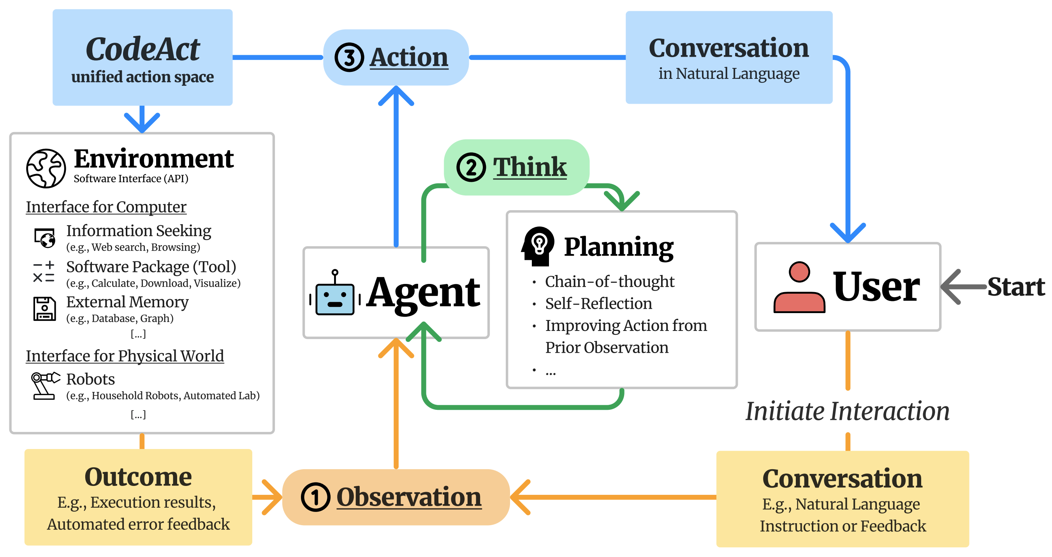
Impact of Open-CodeInterpreter

Slide 49
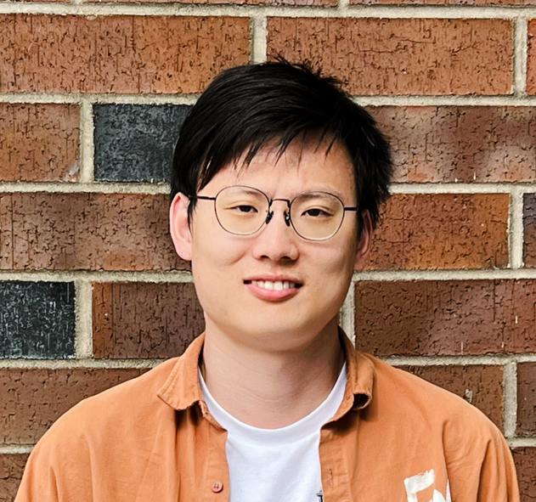
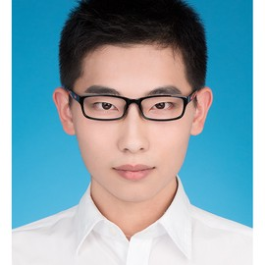
Incentivizing Coding Capabilities by Interaction
ACECODER: Acing Coder RL via Automated Test-Case Synthesis Arxiv 2025
Prompt
Code
RM
PPO
Test-case

Slide 50
Executor Feedback as Reward
Limited gain w/o error message.
Can’t reflect correctness, complexity.
Output Feedback
Test Case 1
Information beyond error.
Can reflect correctness, complexity.
How can we automatically construct test cases?
Test Case 2
Test Case 3
Reward Feedback

Slide 51
Automated Test Case Generation
Seed Noisy Data
Imagine Problem & Test Cases
Filter Problem & Test Cases
Problem
Problem
Code + Text
Blocks
Qwen-Coder-32B
1. assert ()
2. assert ()
3. assert ()
4. assert ()
5. assert ()
6. assert ()
7. assert ()
8. assert ()
1. assert ()
3. assert ()
4. assert ()
7. assert ()
Qwen-Coder-32B
Wei, Yuxiang, et al. "Magicoder: Empowering code generation with oss-instruct." Forty-first International Conference on Machine Learning. 2024.
Luo, Ziyang, et al. "WizardCoder: Empowering Code Large Language Models with Evol-Instruct." The Twelfth International Conference on Learning Representations.

Slide 52
AceCode-87K Dataset
$$q_{1}$$
Test case
Test case
Test case
$$q_{2}$$
Test case
Test case
Test case
Test case
Dataset
$$q_{3}$$
Test case
Test case
$$q_{k}$$
Test case
Test case
$$q_{N}$$
Test case
Test case

Slide 53
RL Training with Test Case Reward
$$r=\left\{\begin{aligned}1 \\ 0 \end{aligned}\right.$$
All test cases passed
Otherwise
$$o_{1}$$
$$A_{1}$$
$$\hat{A}=\frac{A − μ_{A}}{σ_{A}}$$
$${\hat{A}}_{1}$$
$$q$$
Policy
$$π_{θ}$$
$$o_{1}$$
Acc
$$A_{2}$$
Normalize
$${\hat{A}}_{2}$$
$$o_{1}$$
$$A_{3}$$
$${\hat{A}}_{3}$$
Test case
Dataset
I leave out the KL-penalty part for simplicity.

Slide 54
Non-Interactive RL Training
$${\hat{A}}_{1}$$
$$q$$
Policy
$$π_{θ}$$
Acc
$${\hat{A}}_{2}$$
$${\hat{A}}_{3}$$
Test case

Slide 55
Experimental Results (Non-Interactive RL)
Non-Interactive RL
Non-Interactive RL from base

Slide 56
Interactive RL Training
[EOS]
[EOS]
$${\hat{A}}_{1}$$
$$q$$
Policy
$$π_{θ}$$
[EOS]
Acc
$${\hat{A}}_{2}$$
$${\hat{A}}_{3}$$
[EOS]
Test case
[EOS]

Slide 57
Experimental Results (Interactive RL)
Non-Interactive RL

Slide 58
Experimental Results (Interactive RL)
Interactive RL

Slide 59
Talk Outline
Section 1: Math
Interacting with Python Tools
Section 2: Coding
Interacting with Executor
Other Work
Evaluation & Multimodal & RAG
Future Work
Notes:
In this talk, I will cover two sections in math and coding to talk about how to teach foundation models how learn the interactive data generative process.

Slide 60
Evaluation of Foudation Models
MMLU-Pro: A More Robust and Challenging Multi-Task Language Understanding Benchmark Yubo Wang, Xueguang Ma, Ge Zhang, Yuansheng Ni, Abhranil Chandra, Shiguang Guo, Weiming Ren, Aaran Arulraj, Xuan He, Ziyan Jiang, Tianle Li, Max Ku, Kai Wang, Alex Zhuang, Rongqi Fan, Xiang Yue, Wenhu Chen NeurIPS 2024 (Spotlight)
MMMU: A Massive Multi-discipline Multimodal Understanding and Reasoning Benchmark for Expert AGI
Xiang Yue, Yuansheng Ni, Kai Zhang, Tianyu Zheng, Ruoqi Liu, Ge Zhang, Samuel Stevens, Dongfu Jiang, Weiming Ren, Yuxuan Sun, Cong Wei, Botao Yu, Ruibin Yuan, Renliang Sun, Ming Yin, Boyuan Zheng, Zhenzhu Yang, Yibo Liu, Wenhao Huang, Huan Sun, Yu Su, Wenhu Chen CVPR 2024 (Finalist of Best Paper Award)

Slide 61
Retrieval Augmented across Modalities
UniIR: Training and Benchmarking Universal Multimodal Information Retrievers Cong Wei, Yang Chen, Haonan Chen, Hexiang Hu, Ge Zhang, Jie Fu, Alan Ritter, Wenhu Chen ECCV 2024 (Oral)
Unifying Multimodal Retrieval via Document Screenshot Embedding
Xueguang Ma, Sheng-Chieh Lin, Minghan Li, Wenhu Chen, Jimmy Lin EMNLP 2024
LongRAG: Enhancing Retrieval-Augmented Generation with Long-context LLMs
Ziyan Jiang, Xueguang Ma, Wenhu Chen Arxiv 2024
VLM2Vec: Training Vision-Language Models for Massive Multimodal Embedding Tasks
Ziyan Jiang, Rui Meng, Xinyi Yang, Semih Yavuz, Yingbo Zhou, Wenhu Chen ICLR 2025

Slide 62
Controllable Image Generation
Re-Imagen: Retrieval-Augmented Text-to-Image Generator Wenhu Chen, Hexiang Hu, Chitwan Saharia, William W. Cohen ICLR 2023
Subject-driven Text-to-Image Generation via Apprenticeship Learning
Wenhu Chen, Hexiang Hu, Yandong Li, Nataniel Ruiz, Xuhui Jia, Ming-Wei Chang, William W. Cohen NeurIPS 2023
Kosmos-G: Generating Images in Context with Multimodal Large Language Models
Xichen Pan, Li Dong, Shaohan Huang, Zhiliang Peng, Wenhu Chen , Furu Wei ICLR 2024
Instruct-Imagen: Image Generation with Multi-modal Instruction
Hexiang Hu*, Kelvin C.K. Chan*, Yu-Chuan Su*, Wenhu Chen*, Yandong Li, Kihyuk Sohn, Yang Zhao, Xue Ben, Boqing Gong, William Cohen, Ming-Wei Chang, Xuhui Jia CVPR 2024 (Oral)

Slide 63
Image & Video Editing
MagicBrush: A Manually Annotated Dataset for Instruction-Guided Image Editing
Kai Zhang, Lingbo Mo, Wenhu Chen, Huan Sun, Yu Su NeurIPS 2023
OmniEdit: Building Image Editing Generalist Models Through Specialist Supervision
Cong Wei, Zheyang Xiong, Weiming Ren, Xinrun Du, Ge Zhang, Wenhu Chen ICLR 2025
AnyV2V: A Tuning-Free Framework For Any Video-to-Video Editing Tasks
Max Ku, Cong Wei, Weiming Ren, Harry Yang, Wenhu Chen TMLR 2024

Slide 64
Talk Outline
Section 1: Math
Interacting with Python Tools
Section 2: Coding
Interacting with Executor
Other Work
Evaluation and Multimodal
Future Work
Notes:
In this talk, I will cover two sections in math and coding to talk about how to teach foundation models how learn the interactive data generative process.

Slide 65
Interactive Deep Thinking
search
database
interpreter
python
simulator
system
Deep thinking
Search
How can we improve Deep (Re)Search?
Domain-specific Tools

Slide 66
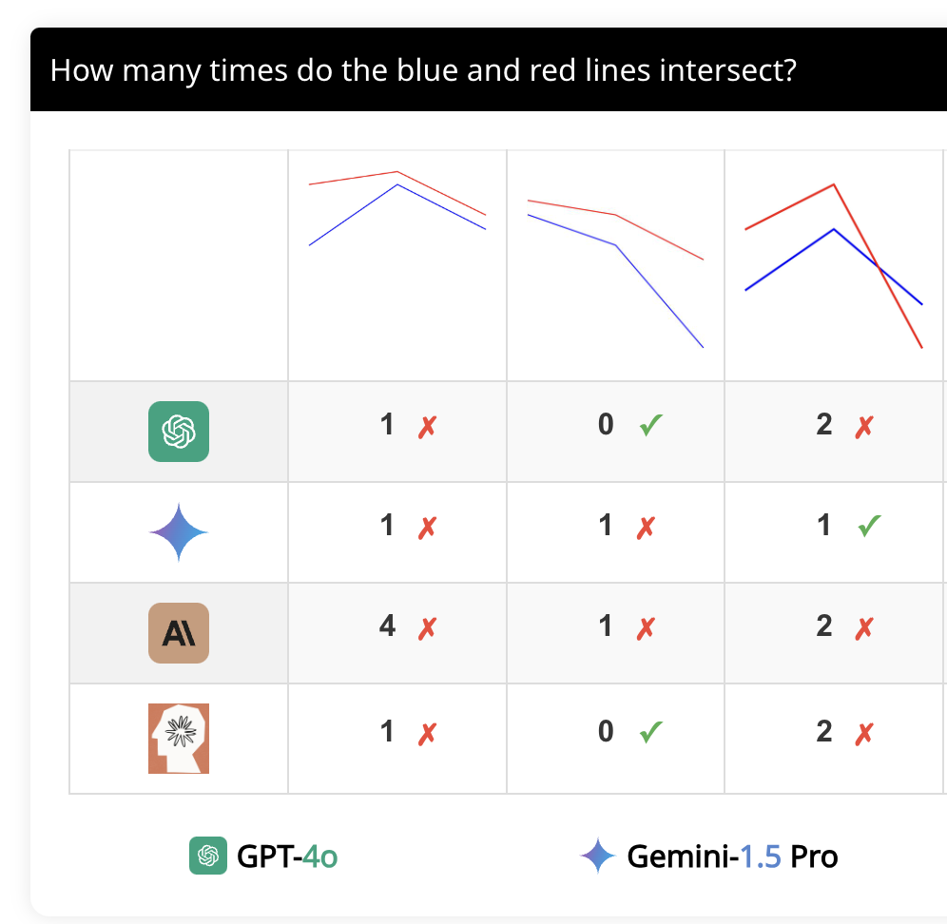
Interactive Reasoning in Pixel Space
100,000 tokens
Vision Enc
Fail simple test
1000 tokens
Vision Enc
Reasoning VLMs
Can we put more reasoning effort in the pixel space?
Interaction

Slide 67
Human-AI Collaboration
How can we collaborate with AI to solve problems that humanity couldn’t solve?
Which part should humans do?
How can we verify their answers if we can’t even understand their reasoning.
In near future, AI will become much better than the smartest humans.

Slide 68
Acknowledgement

